Slide 1
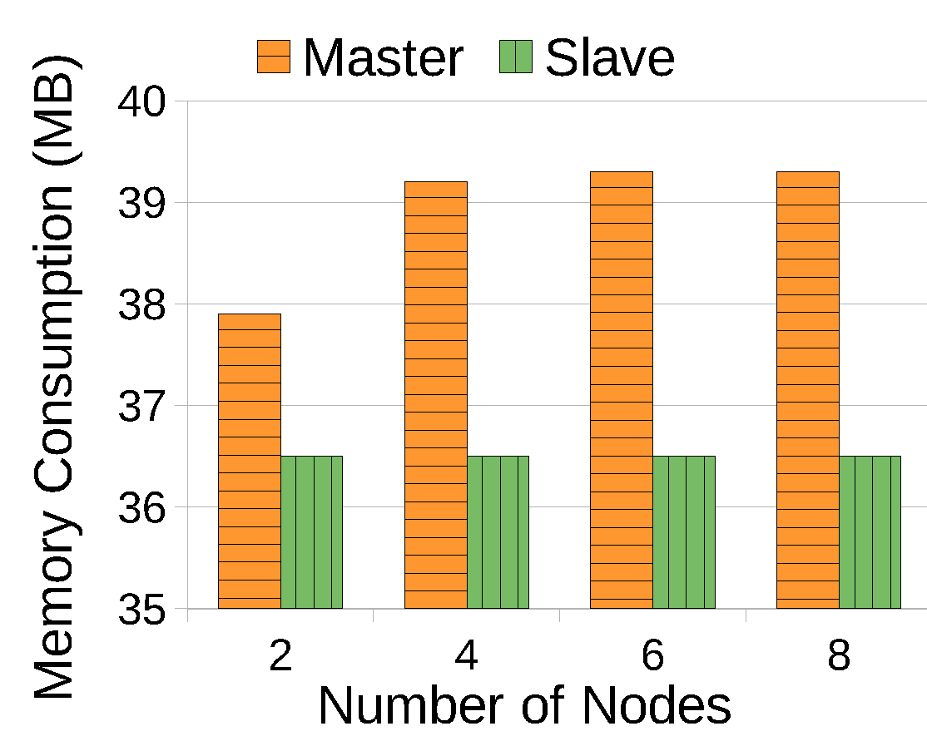
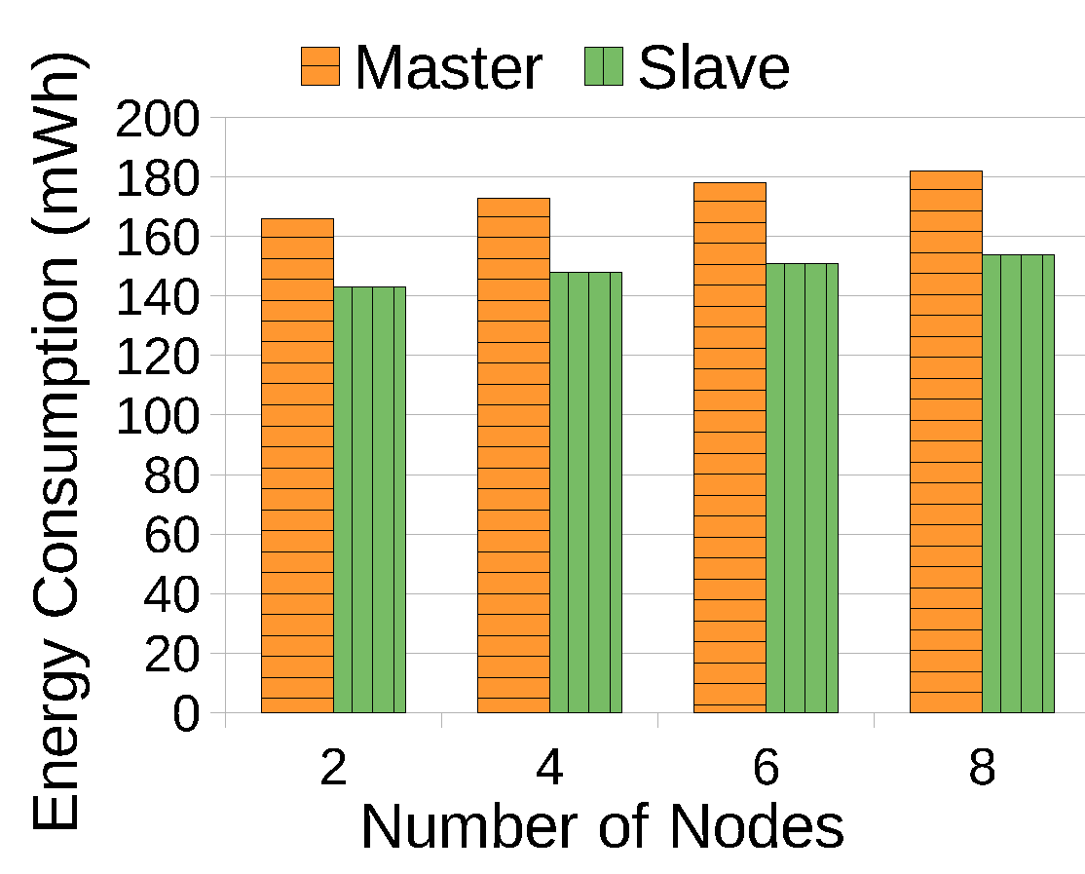
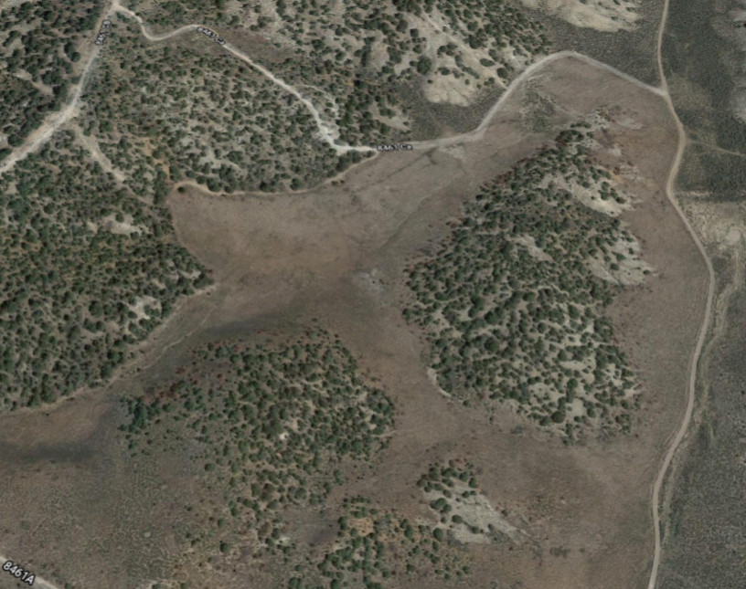
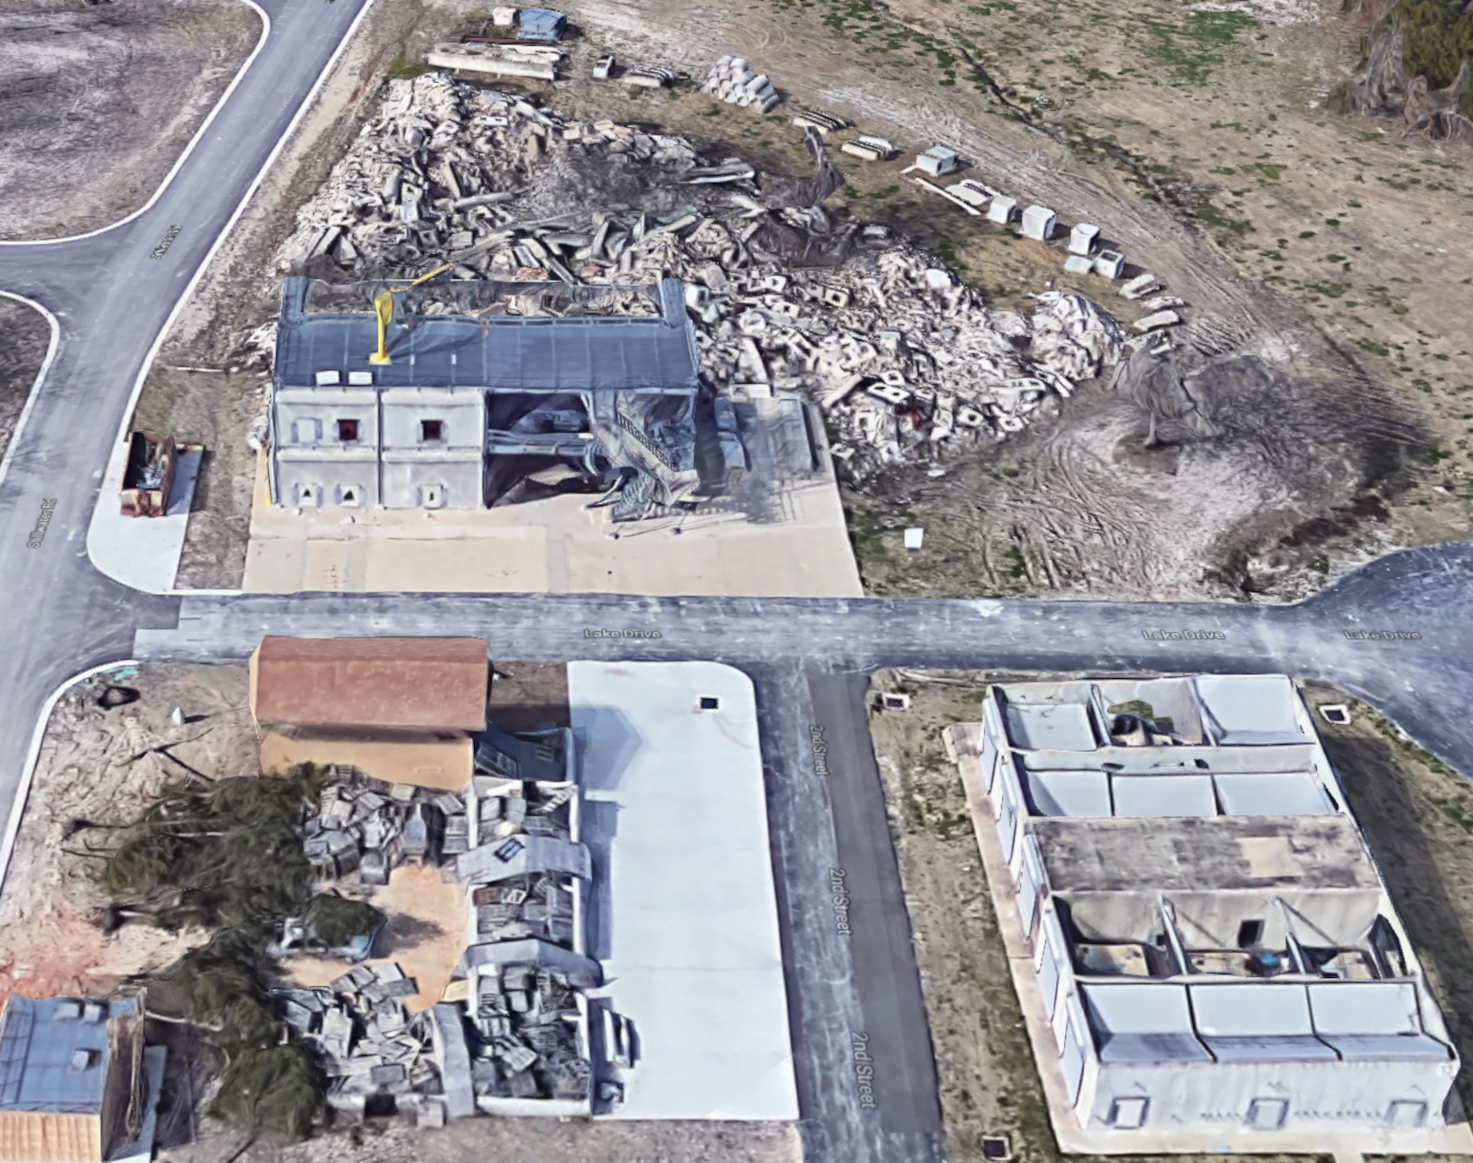
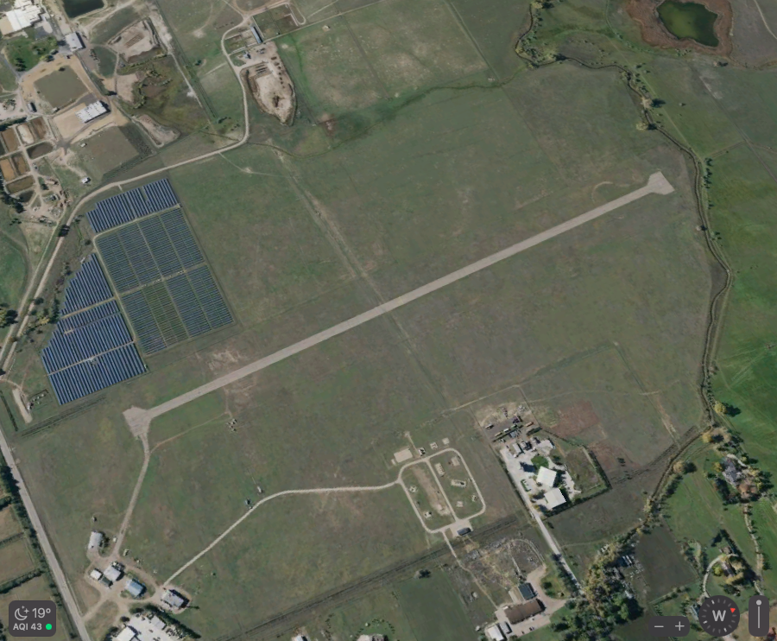
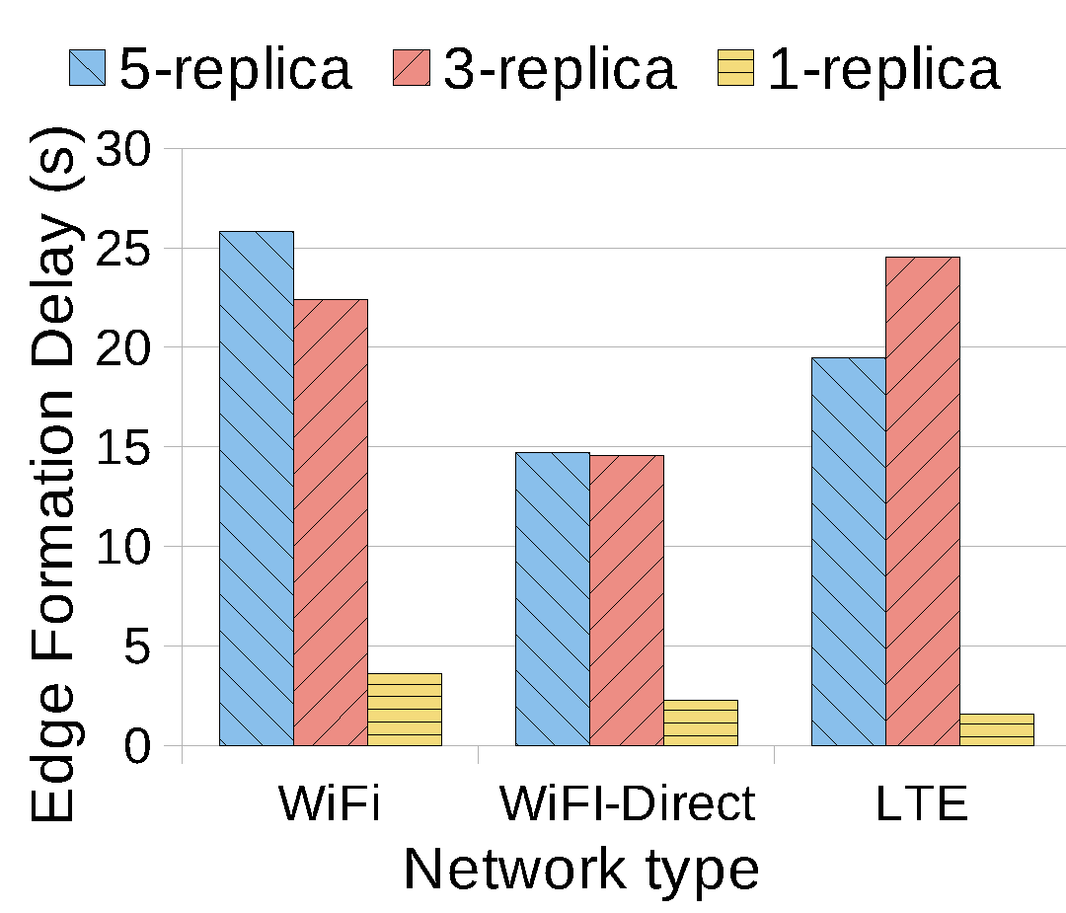
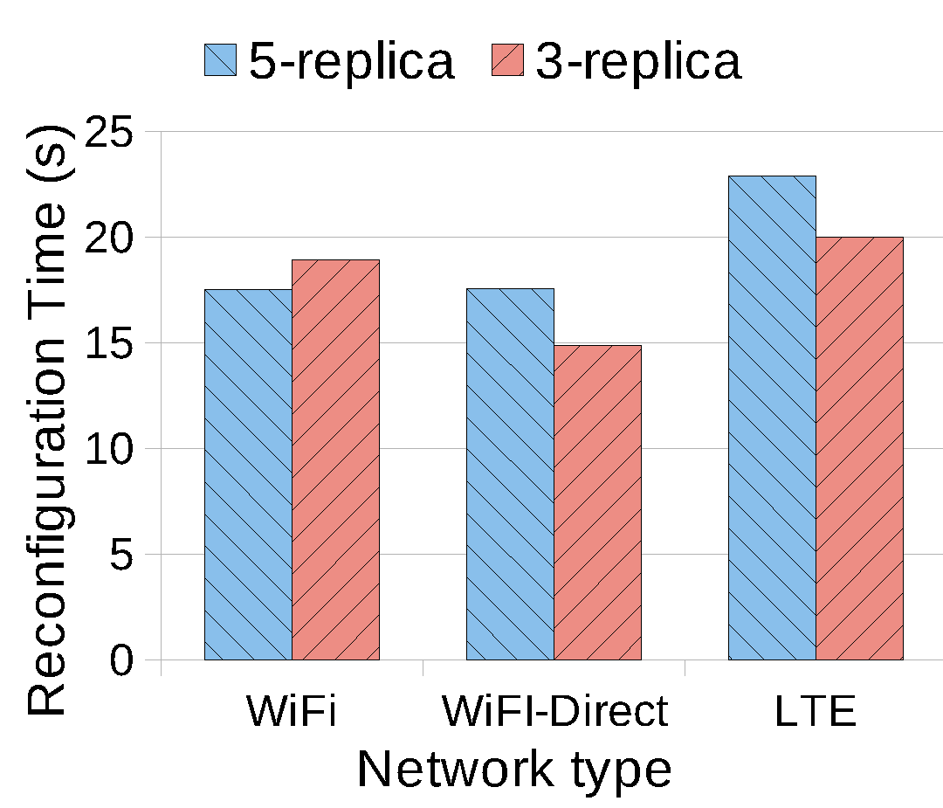
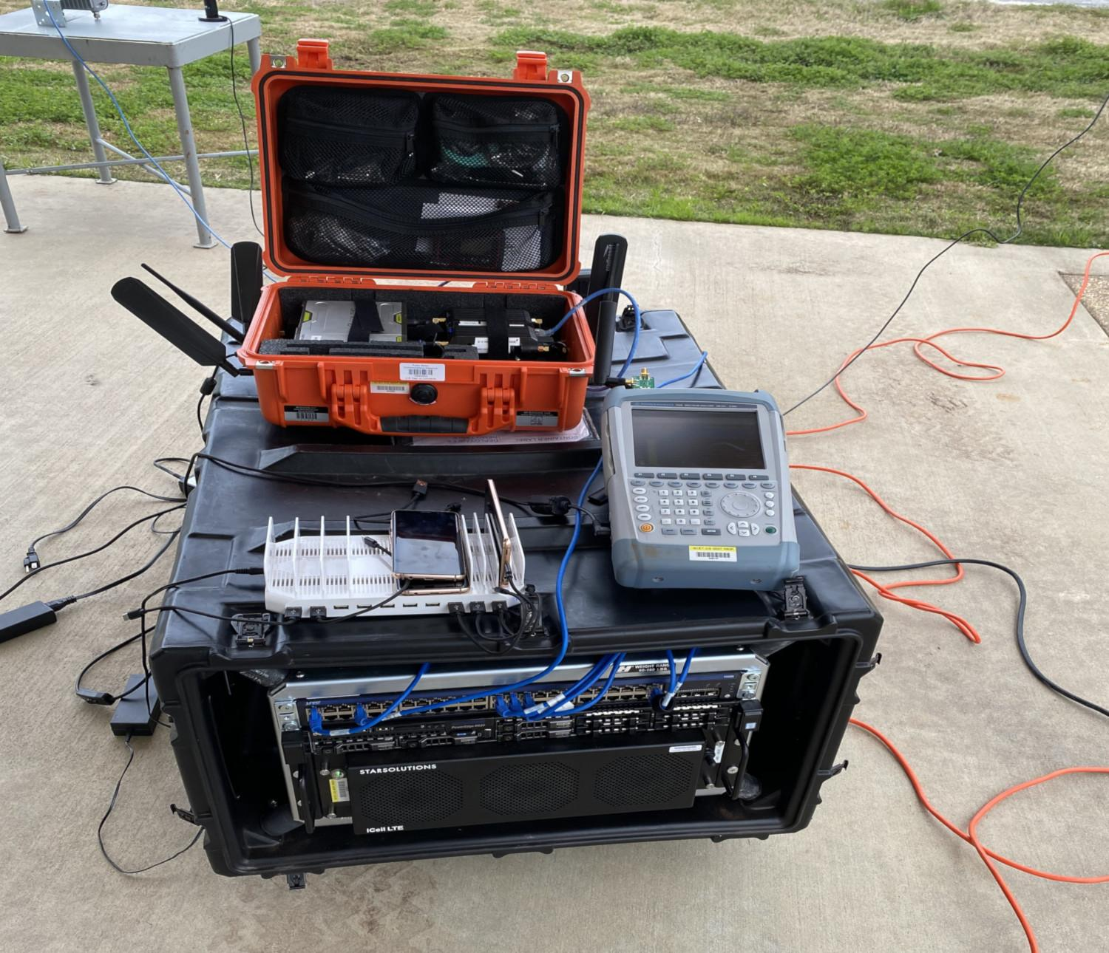
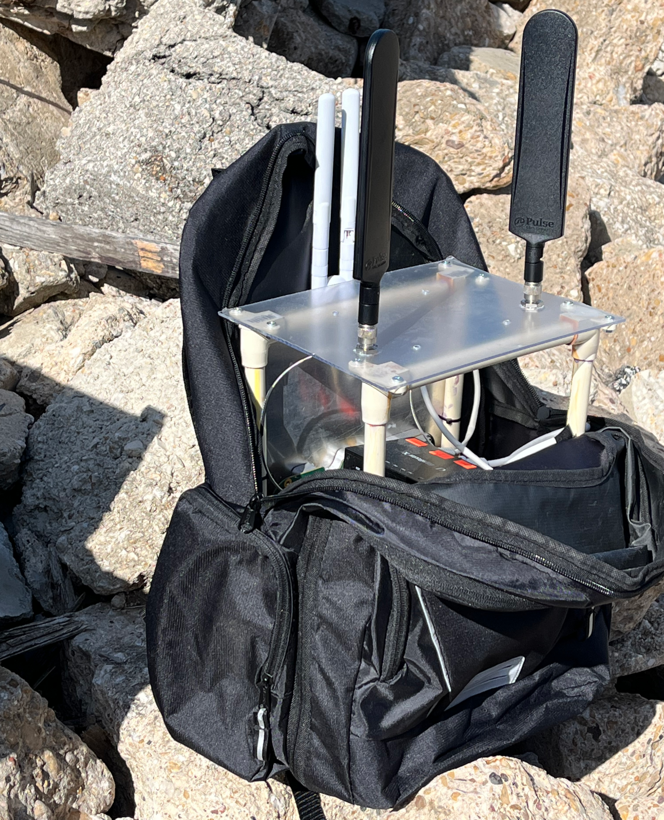
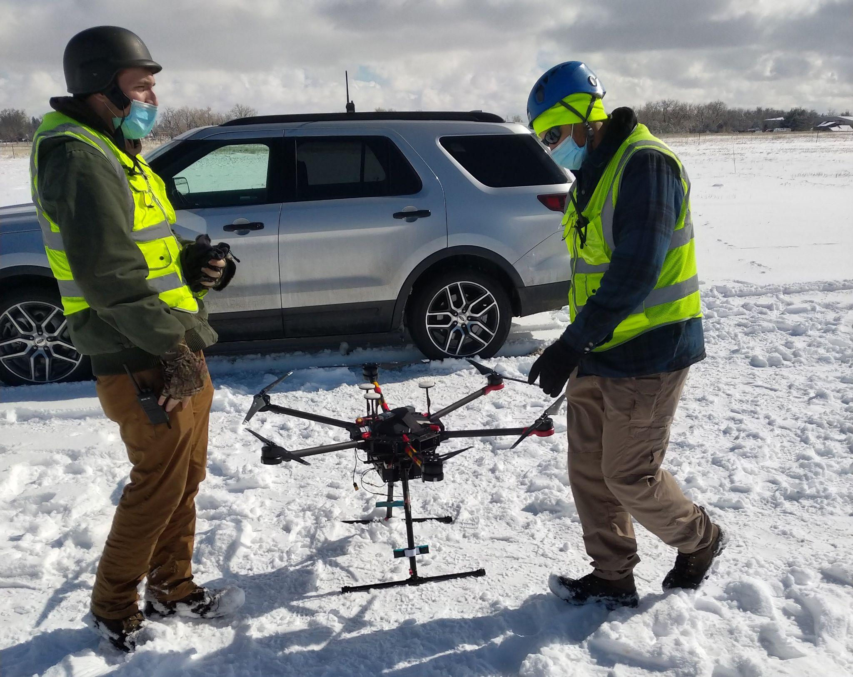
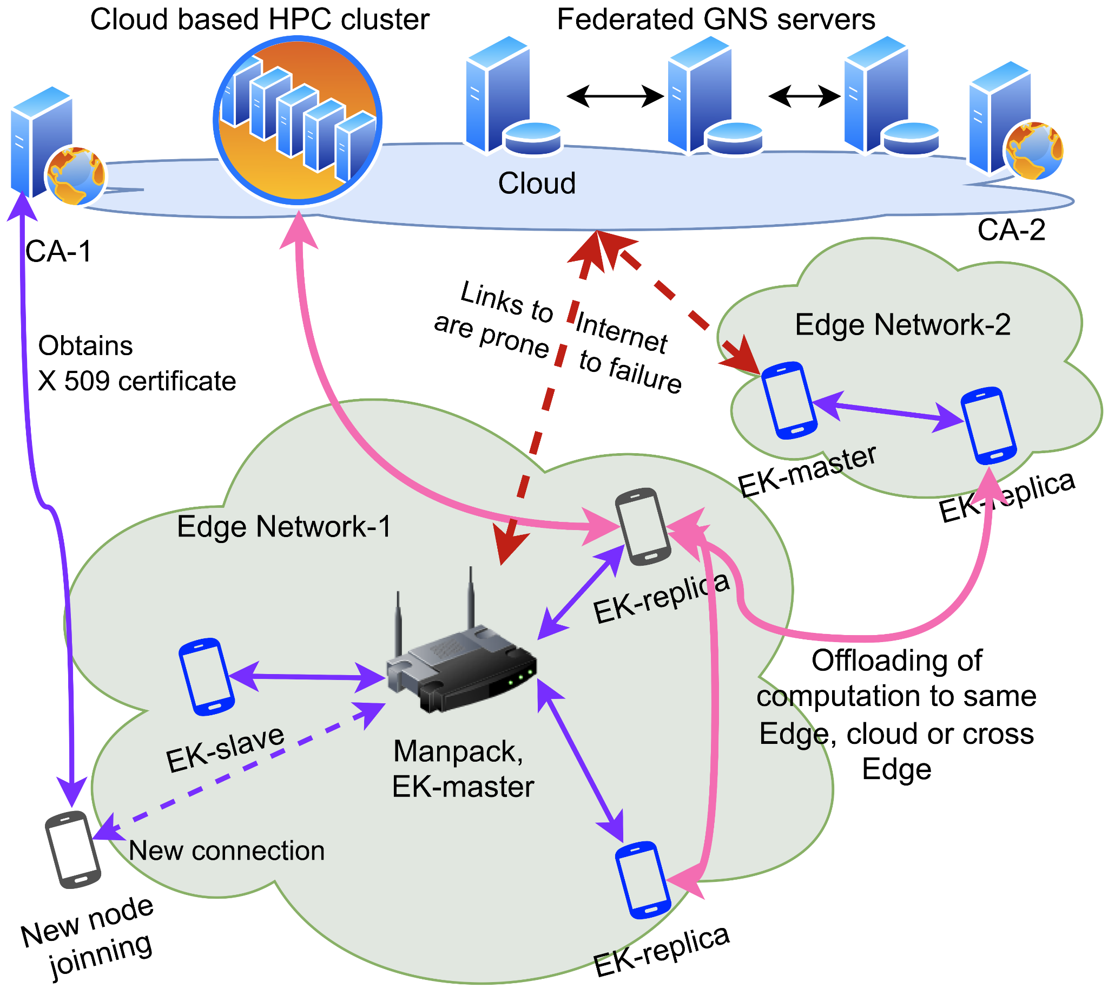
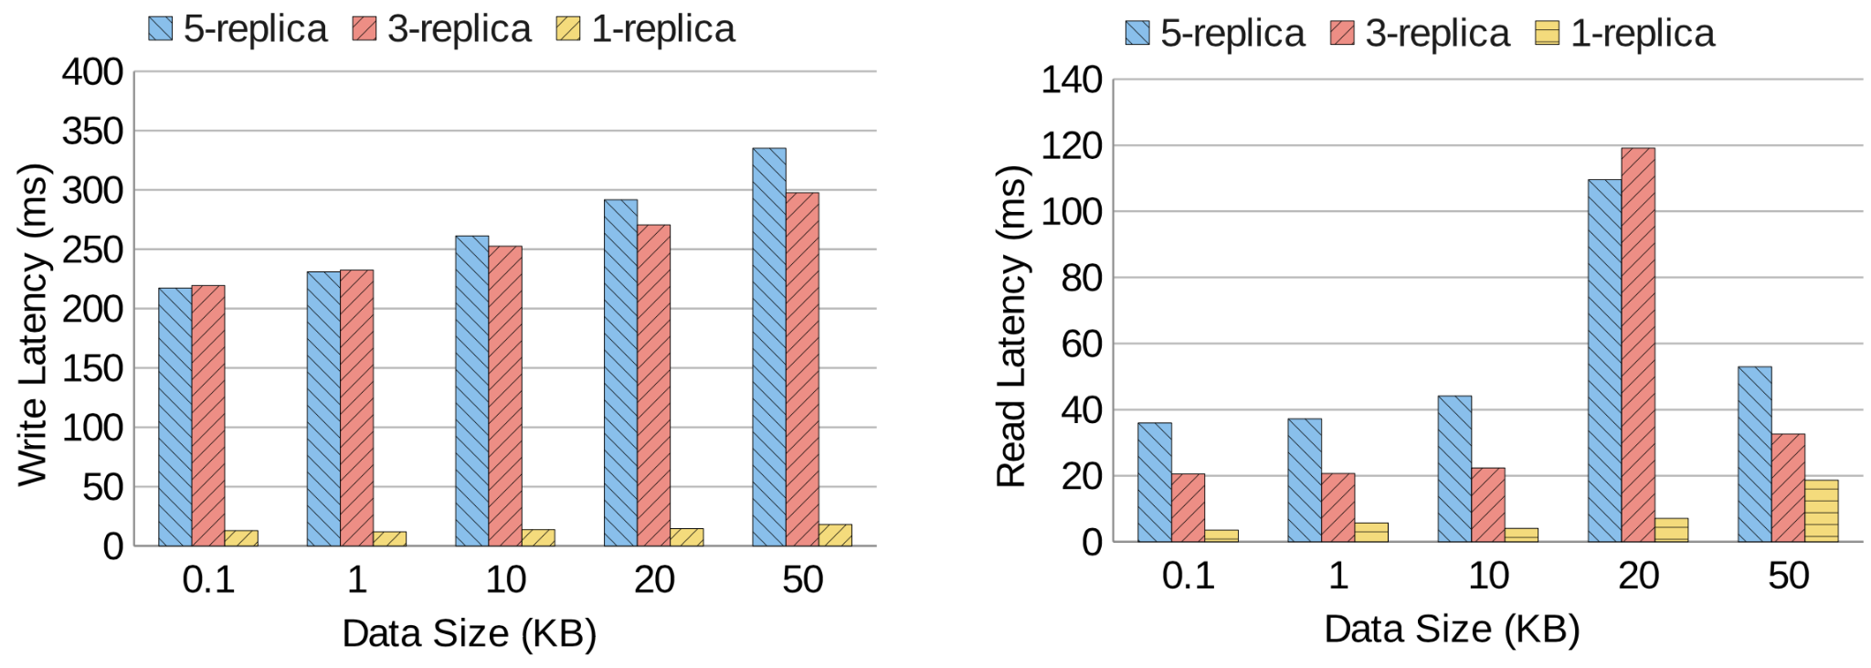
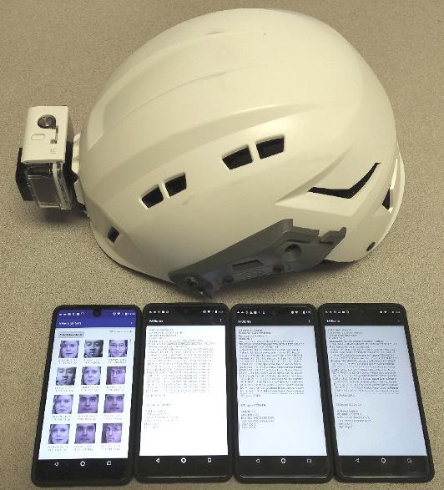
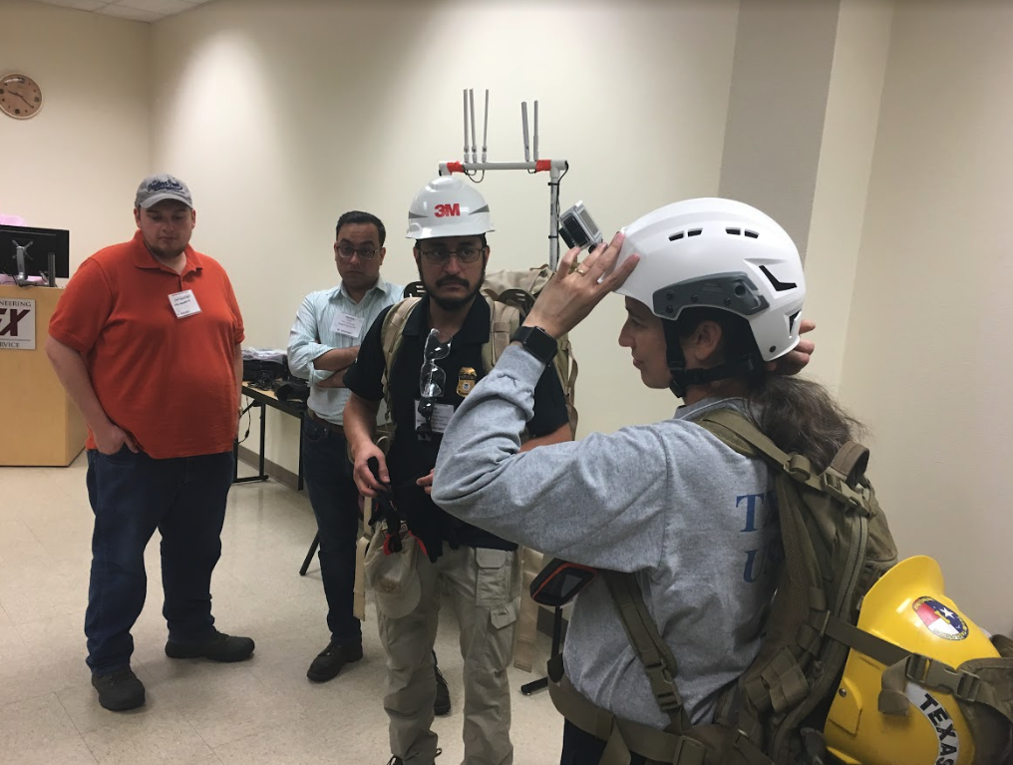
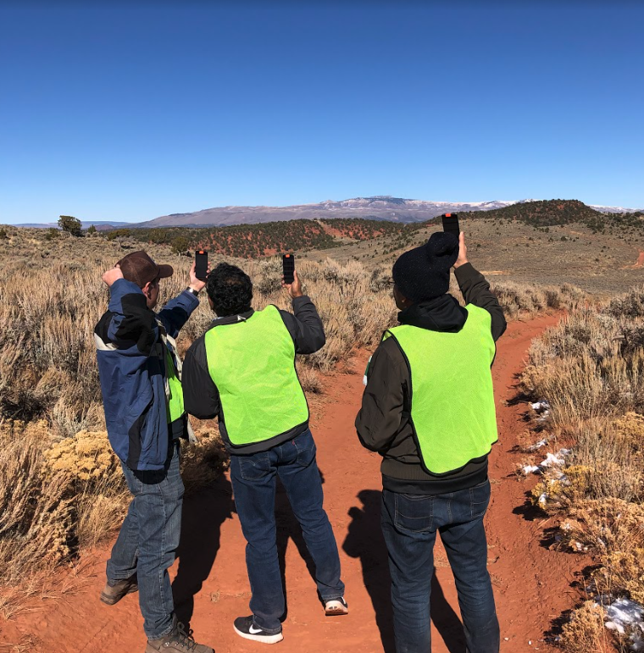
EdgeKeeper – Resilient and Lightweight Coordination
for Mobile Edge Computing Systems
S. Bhunia, R. Stoleru, A. Haroon, M. Sagor, A. Altaweel, M. Chao, M. Maurice, R. Blalock {sbhunia, stoleru, amran.haroon, msagor, altaweelala1983, chaomengyuan}@tamu.edu, {maxwell.maurice, roger.blalock}@nist.gov
Motivation
EdgeKeeper Services
Evaluation
Identity & device naming - GNS and local cache at Edge
Authentication - X509 based certificates
Service Discovery and Coordination - for client applications at Edge
Resilient MetaData Storage - fault tolerance and consensus
Monitor Edge Status - Edge Topology and device resource status
EdgeKeeper cluster needs on an average 20s to 25s for multiple replicas
Starts working in seconds in a single replica configuration
Real-world deployment
Experiments carried out in different locations, environments, and diverse scenarios.
Gypsum, CO - LTE only network in a mountainous region.
Disaster City, TX - involves first responders with a deployable manpack
Christman Air Field, CO - drone (UAV) based deployment
Handheld device assisted disaster response missions
Real-time and computing heavy tasks such as face detection, face recognition, and voice assistance.
No cellular wireless infrastructure
Mobile devices form a distributed edge computing cluster
Devices offload computing jobs to other devices at the edge
Memory consumption - below 40MB
CPU consumption - within 0.16% of a single core
Power consumption - (0.17W/h) which is very low
Resource consumption on device increases with the network size
Associativity with other Edge Applications
Similar to Apache Hadoop ecosystem
EdgeKeeper runs on all devices at the edge network
Provides a comprehensive API
WiFi, WiFi-Direct, and LTE networks in diverse network environments
Observed Latency for client API calls are within 8ms
Average response time increases when phones are more than 100 m apart
EdgeKeeper Architecture
Equipped first responders for several types of search and rescue missions
Applications: Resilient data storage, MMR, and MStorm as client applications
Conclusions
We present EdgeKeeper, a resilient cloud-like application coordination service for mobile edge computing. The tests with real-world deployment showed that EdgeKeeper automatically discovers devices in the edge network, quickly forms an edge cluster, and reconfigures it after node departures.

Slide 2
EdgeKeeper – Resilient and Lightweight Coordination
for Mobile Edge Computing Systems
S. Bhunia, R. Stoleru, A. Haroon, M. Sagor, A. Altaweel, M. Chao, M. Maurice, R. Blalock {sbhunia, stoleru, amran.haroon, msagor, altaweelala1983, chaomengyuan}@tamu.edu, {maxwell.maurice, roger.blalock}@nist.gov
Motivation
EdgeKeeper Services
Evaluation
Identity & device naming - GNS and local cache at Edge
Authentication - X509 based certificates
Service Discovery and Coordination - for client applications at Edge
Resilient MetaData Storage - fault tolerance and consensus
Monitor Edge Status - Edge Topology and device resource status
EdgeKeeper cluster needs on an average 20s to 25s for multiple replicas
Starts working in seconds in a single replica configuration
Real-world deployment
Experiments carried out in different locations, environments, and diverse scenarios.
Gypsum, CO - LTE only network in a mountainous region.
Disaster City, TX - involves first responders with a deployable manpack
Christman Air Field, CO - drone (UAV) based deployment
Handheld device assisted disaster response missions
Real-time and computing heavy tasks such as face detection, face recognition, and voice assistance.
No cellular wireless infrastructure
Mobile devices form a distributed edge computing cluster
Devices offload computing jobs to other devices at the edge
Memory consumption - below 40MB
CPU consumption - within 0.16% of a single core
Power consumption - (0.17W/h) which is very low
Resource consumption on device increases with the network size
Associativity with other Edge Applications
Similar to Apache Hadoop ecosystem
EdgeKeeper runs on all devices at the edge network
Provides a comprehensive API
WiFi, WiFi-Direct, and LTE networks in diverse network environments
Observed Latency for client API calls are within 8ms
Average response time increases when phones are more than 100 m apart
EdgeKeeper Architecture
Equipped first responders for several types of search and rescue missions
Applications: resilient data storage, MMR, and MStorm as client applications
Conclusions
We present EdgeKeeper, a resilient cloud-like application coordination service for mobile edge computing. The tests with real-world deployment showed that EdgeKeeper automatically discovers devices in the edge network, quickly forms an edge cluster, and reconfigures it after node departures.

