Slide 1
Analyzing the Ransomware Attack on D.C. Metropolitan Police Department by Babuk
Emily Caroscio, Jack Paul, John Murray, Dr. Suman Bhunia
Syscon 2022
Aerospace Systems Engineering Special Session

Slide 2
Presenters
Emily Caroscio
Miami University ‘22
B.S. in Software Engineering
Co-author
Jack Paul
Miami University ‘22
B.S. in Software Engineering
Co-author

Slide 3
Table of Contents
Introduction into Ransomware
Background Into Babuk and Their Major Victims
Serco Group
The D.C. Metropolitan Police Department
Ransomware Attacks on the Aerospace Industry
Babuk Attack Methodology
Gaining Access
Maintaining Access
Demanding Ransom
Impact of the D.C. Metropolitan Police Department Attack
Possible Countermeasures

Slide 4
Introduction to Ransomware
Cybercriminals attack organizations across the globe using malicious software (malware)
Ransomware is one of the easiest to use and most common forms of malware
Ransomware kits can be purchased on the dark web for as little as $175, and require little to no technology background to operate [1]
In the first half of 2021, there were 121 reported ransomware attacks, up 64% from the year prior [1]
Most ransomware operates by using an asymmetrical cryptography system [2]
Data is encrypted, public/private key pairs are generated for both the attacker and the victim
However, only the attacker has access to the private key which allows the data to be decrypted
[1] “2021 Ransomware Statistics, Data, Trends.” https://www.cybersecuritydive.com/news/babuk-ransomware-group-emerges-with-new-claims-against-us-companies/597416/, 2021.
[2] A. Tandon and A. Nayyar, A Comprehensive Survey on Ransomware Attack: A Growing Havoc Cyberthreat: Proceedings of ICDMAI 2018, Volume 2, pp. 403–420. 01 2019.

Slide 5
Background of Babuk Group
Babuk ransomware was first detected in early 2021 [3]
The group thinks of themselves as ‘network testers’ whose ransom is just repayment for their ‘services’
Babuk’s victims:
Operate in the aerospace, transportation, healthcare, plastic, electronics, and agricultural industries [3]
Are based in the United States, the United Kingdom, Spain, Italy, India, and China [3]
The group does not attack:
Hospitals
Non-profit organizations
Companies with a yearly revenue less than 4 million USD
[3] A. Mundo, T. Seret, T. Roccia, and J. Fokker, “Technical Analysis of Babuk Ransomware.” https://www.mcafee.com/enterprise/en-us/assets/reports/rp-babuk-ransomware.pdf, 2021.

Slide 6
Background of Babuk Group (continued)
Babuk uses a set of forums to communicate within their group and to the general public [4]
English-speaking forums are used to announce attacks and leak victim data in hopes of pressuring them into paying ransom
Russian-speaking forums are used for members to communicate with one another and to advertise recruitment to the group
Babuk typically recruits individuals with skills in open-source penetration testing tools [3]
[3] A. Mundo, T. Seret, T. Roccia, and J. Fokker, “Technical Analysis of Babuk Ransomware.” https://www.mcafee.com/enterprise/en-us/assets/reports/rp-babuk-ransomware.pdf, 2021.
[4] “Threat analysis: Babuk ransomware.” https://www.acronis.com/en-us/articles/babuk-ransomware/, 2021.

Slide 7
Major Victims of Babuk Ransomware
Serco Group
Contractors based in England whose services range across a variety of industries, including aerospace and defense
Serco’s yearly revenue within the aerospace industry in 2018 totaled 947 million GBP [5]
In January 2021, 700 GB of their data was encrypted by Babuk ransomware
The D.C. Metropolitan Police Department (DCMPD)
One of the largest police departments in the United States that serves the greater metropolitan area of the District of Columbia [6]
Due to its location, the DCMPD occasionally lends itself to the United States Capitol [7]
In April 2021, 250 GB of their data was encrypted by Babuk ransomware [8]
[5] “Serco in Defence.” https://www.serco.com/sector-expertise/defence, 2022.
[6] “MPDC: Mission and Value Statement.” https://mpdc.dc.gov/page/mpdc-mission-and-value-statement, 2021.
[7] M. Austermuhle, “D.C. Metro Police Describe Being First Responders To Insurrection At The Capitol.” https://www.npr.org/2021/01/16/957695863/dc-metro-police-describe-being-first-responders-to-insurrection-at-the-capitol, 2021.
[8] A. Suderman, “DC police victim of massive data leak by ransomware gang.” https://apnews.com/article/police-technology-government-and-politics-1aedfcf42a8dc2b004ef610d0b57edb9, 2021.

Slide 8
Ransomware and the Aerospace Industry
Ransomware attackers target the aerospace industry to steal intellectual property & other types of sensitive information
This means they can potentially gather information on developing countermeasures to a nation’s aerospace & defense systems [9]
Vulnerabilities ransomware attackers look for within aerospace systems include:
Unchecked vulnerabilities from integration of software/hardware between differing systems [10]
The OS kernel and other lower-layer processes [10]
Attacks on an aircraft’s systems can result in the corruption of core functions and failure-tolerant processes [10]
[9] “Cyber threats to the aerospace and defense industries.” https://www.fireeye.com/current-threats/reports-by-industry/aerospace- threat-intelligence.html, 2021.
[10] E. Ukwandu, M. A. Ben-Farah, H. Hindy, M. Bures, R. Atkinson, C. Tachtatzis, I. Andonovic, , and X. Bellekens, “Cyber-Security Challenges in Aviation Industry: A Review of Current and Future Trends.” https://www.mdpi.com/2078-2489/13/3/146, 2021.

Slide 9
Ransomware and the Aerospace Industry (continued)
Examples of major ransomware attacks on organizations in the aerospace industry include:
The Zurich Airport
In February 2022, a ransomware attack on Swissport, the Zurich airport’s ground services and cargo operator, grounded 22 flights and compromised the overall security of the airport for a short time [11]
ST Engineering
A ransomware attack on ST Engineering in June 2020 resulted in the theft and encryption of 1.5 TB of sensitive aerospace data [12]
Equivalent of 124.5 million pages of text
PDI Group
PDI Group had 700 GB of data stolen and encrypted from them in a ransomware attack in 2021 [13]
This data included not only sensitive company information but also personal employee information
[11] “Ransomware attack on Swissport causes delay at Zurich Airport.”
https://www.airport-technology.com/news/ransomware-attack-swissport-zurich-airport/, 2022.
[12] F. Erazo, “Ransomware Attack Exposes 1.5TB of Stolen Aerospace Data.” https://cointelegraph.com/news/ransomware-attack-exposes-15tb-of-stolen-aerospace-data, 2020.
[13] D. Jones, “Babuk ransomware group emerges with new claims against US companies.” https://www.cybersecuritydive.com/news/babuk-ransomware-group-emerges-with-new-claims-against-us-companies/597416/, 2021.

Slide 10
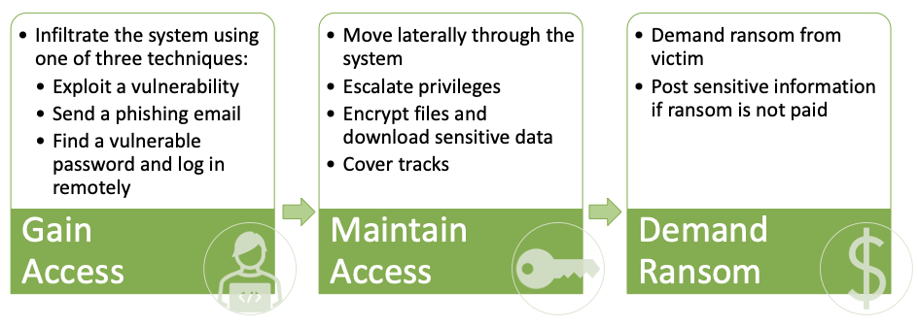
Babuk Attack Methodology Phases
[14] N. Thibault Seret, Noel Keijzer, “Babuk : Moving to VM and * nix Systems Before Stepping Away.” https://www.mcafee.com/enterprise/en-us/assets/reports/rp-babuk-moving-to-vm-nix-systems.pdf, 2021.
Notes:
In every cyber crime

Slide 11
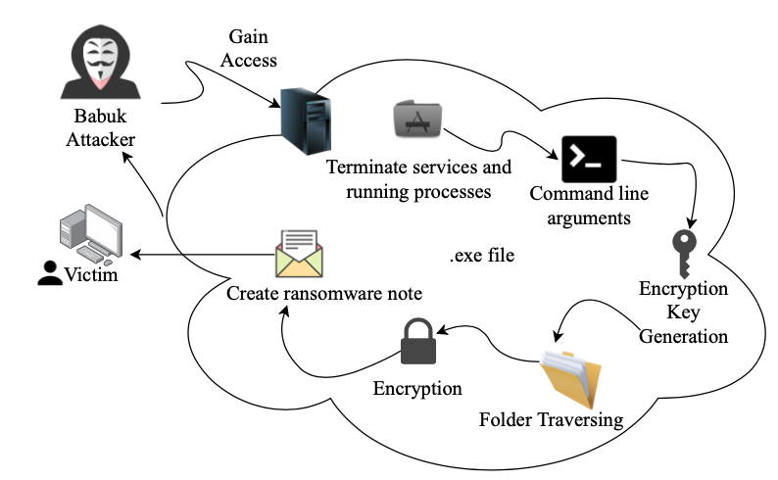
Maintaining Access
Cycle of source code [15]
Mutex versions of the .exe
v1 [3][15]
babuk_v2 [14]
DoYouWantToHaveSexWithCoungDong[4]
Uses command line operations [3]
empties recycle bin
delete shadow volumes
cover tracks
Adds custom extension to files (.babyk, .babuk) [4]
[3] A. Mundo, T. Seret, T. Roccia, and J. Fokker, “Technical Analysis of Babuk Ransomware.” https://www.mcafee.com/enterprise/en-us/assets/reports/rp-babuk-ransomware.pdf, 2021.
[4] “Threat analysis: Babuk ransomware.” https://www.acronis.com/en-us/articles/babuk-ransomware/, 2021.
[14] N. Thibault Seret, Noel Keijzer, “Babuk : Moving to VM and * nix Systems Before Stepping Away.” https://www.mcafee.com/enterprise/en-us/assets/reports/rp-babuk-moving-to-vm-nix-systems.pdf, 2021.
[15] C.Dong, “Babuk Ransomware.” https://chuongdong.com/reverse%20engineering/2021/01/03/BabukRansomware/, 01 2021.
Notes:
shadow volumes - can create backup copies or snapshots of computer files or volumes, recover files that have been accidentally deleted

Slide 12
Maintaining Access
Services Terminated [4]
Anti-Malware Services Terminated [4]
sql.exe,
firefox.exe,
outlook.exe,
onenote.exe,
powerpnt.exe
GxVss,
GxBlr,
GxFWD,
DefWatch
[4] “Threat analysis: Babuk ransomware.” https://www.acronis.com/en-us/articles/babuk-ransomware/, 2021.

Slide 13
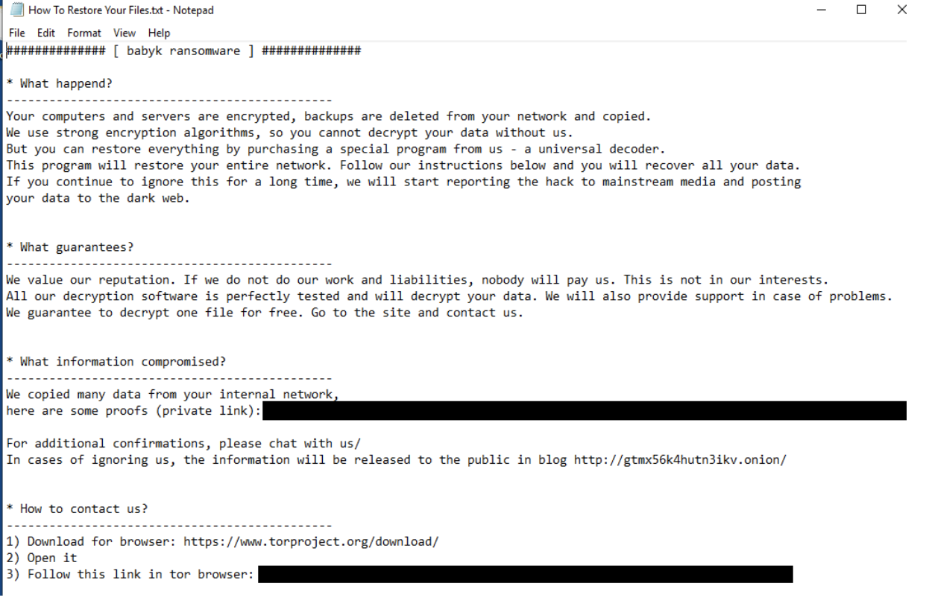
Demand Ransom - DCMPD
Contains contact information and links demonstrating proof of the attack through the TOR network [4]
[4] “Threat analysis: Babuk ransomware.” https://www.acronis.com/en-us/articles/babuk-ransomware/, 2021.

Slide 14
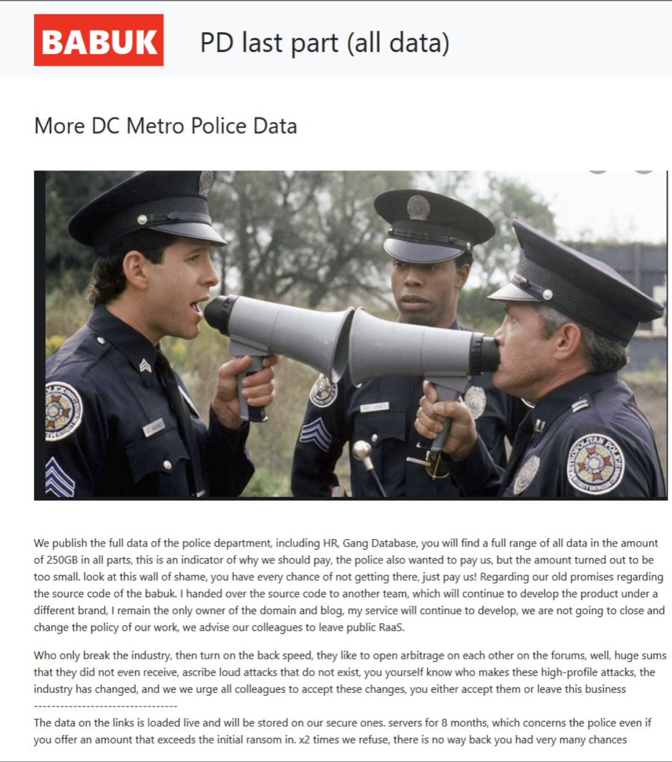
Demand Ransom -DCMPD
Announcement post from the Babuk forum [4]
Ultimately, ransom was not paid to Babuk by the DCMPD
[4] “Threat analysis: Babuk ransomware.” https://www.acronis.com/en-us/articles/babuk-ransomware/, 2021.

Slide 15
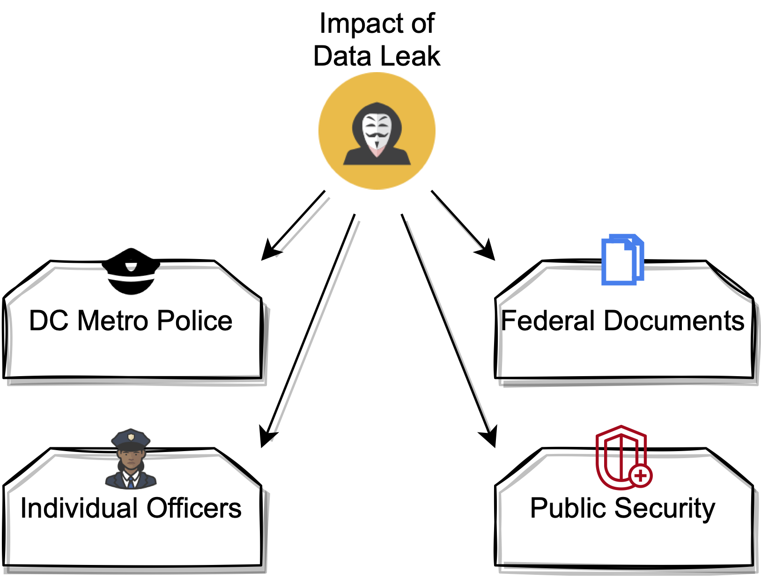
Impact of the DCMPD Attack
Information leaked on numerous officers included:
Psych evaluations
Past drug use
Financial information
Background checks
Disciplinary actions
Social Security numbers
Marriage history
And more
[16] T. Brewster, “Ransomware Hackers Claim To Leak 250GB Of Washington, D.C., Police Data After Cops Don’t Pay 4 Million Ransom.” https://www.forbes.com/sites/thomasbrewster/2021/05/13/ransomware-hackers-claim-to-leak-250gb-of-washington-dc-police-data-after-cops-dont-pay-4-million-ransom/?sh=60b3b3b058d0, 2021.

Slide 16
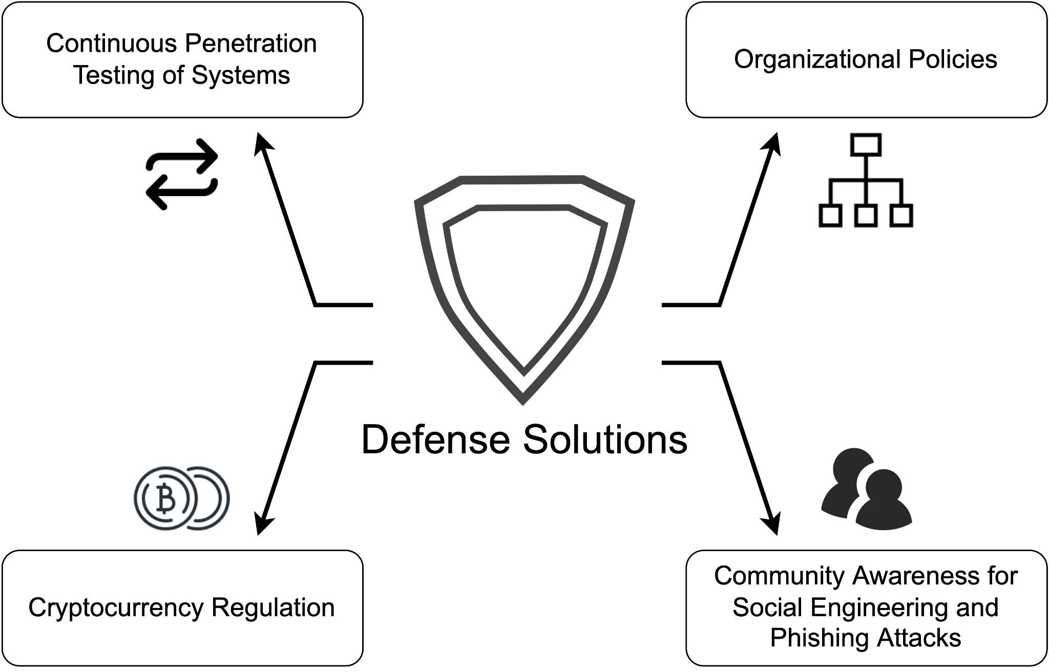
Potential Countermeasures to Ransomware

Slide 17
Potential Countermeasures to Ransomware
Testing tools [3]
winPEAS
SharpHound
Colbalt Strike
Metaspoit
Covenant
Indicators of Compromise [17]
Monitor for suspicious activity
Used during incident response
[3] A. Mundo, T. Seret, T. Roccia, and J. Fokker, “Technical Analysis of Babuk Ransomware.” https://www.mcafee.com/enterprise/en-us/assets/reports/rp-babuk-ransomware.pdf, 2021.
[17] “What are Indicators of Compromise?.” https://www.proofpoint.com/us/threat-reference/indicators-compromise, 2022.

Slide 18
Potential Countermeasures to Ransomware
Regulating Bitcoin globally can help target malicious users [18]
[18] C. D. Angela S.M. Irwin, “Following the cyber money trail: Global challenges when investigating ransomware attacks and how regulation can help.” https://www.emerald.com/insight/content/doi/10.1108/JMLC-08-2017-0041/full/html, 2019.

Slide 19
Potential Countermeasures to Ransomware
Government should encourage more organizations to implement best safety practices and protect businesses from all types of malware [19]
[19] F. Ordonez, “In Wake Of Pipeline Hack, Biden Signs Executive Order On Cybersecurity.” https://www.npr.org/2021/05/12/996355601/in-wake-of-pipeline-hack-biden-signs-executive-order-on-cybersecurity, 2021.

Slide 20
Potential Countermeasures to Ransomware
Nearly 1/4 of ransomware victims report that phishing was how attackers initially penetrated their system
Of those victims, over 1/2 had conducted anti-phishing training in their organization to some degree
Increasing best practices with avoiding phishing attacks can help an organization’s system from being penetrated in the first place
[20] “Phishing continues to be one of the easiest paths for ransomware.” https://www.zdnet.com/article/phishing-continues-to-be-one-of-the-easiest-paths-for-ransomware-report/, 2021.

Slide 21
In Conclusion
Babuk’s targeted attacks on Serco and the DCMPD show that no industry or organization is safe from ransomware
Safe and effective ways that large organizations can use to increase their ransomware awareness are:
Increasing awareness of phishing attacks
Implementing a solid incident response plan to combat ransomware and other forms of malware
Updating or patching legacy software
Following the latest government regulations
Research areas for future ransomware prevention include:
Malware mutex detection through techniques like YARA rules
Safer decryption methods for ECDH encryption and other similar encryption techniques
Research into global regulation of bitcoin transactions

Slide 22
Thank You

