Slide 2
CROSS-DEVICE FEDERATED INTRUSION DETECTOR FOR EARLY STAGE BOTNET PROPAGATION
Angela G. Famera, Raj M. Shukla, and Suman Bhunia
Notes:
Hello everyone and thank you for attending my thesis defense.
During the presentation feel free to interrupt me if you have any questions and I will answer them to the best of my ability

Slide 3
Contents
Introduction & Background
Proposed IDS Architecture
Data Compilation and Processing
Experimental Setup
Results & Discussion
Conclusion
Notes:
Now to the presentation.
This slide displays the outline of today presentation.
We will begin with an introduction and some background information.
We will summarize our proposed architecture for our model,
then we will discuss our data compilation and experimental setup.
Afterwards we will end with some of our results and conclude the presentation

Slide 4
Introduction & Background

Slide 5
Motivation
In 2019, 65% of business leaders felt their cybersecurity risks were increasing, and the average cost of a malware attack on a company was $2.6 million
In 2020, 64% of Americans admitted to never checking to see if they were affected by a data breach
Attacks on Internet of Things (IoT) devices tripled in the first half of 2019
The Mirai botnet was the third most common IoT threat in 2018
By 2025, there will be 41.6 billion connected IoT devices generating 79 zettabytes of data, and damage related to cybercrime is projected to hit $10.5 trillion annually
Notes:
In 2019, 65% of business leaders felt their cybersecurity risks were increasing, and in that same year the average cost of a malware attack on a company was $2.6 million dollars.
In 2019, attacks on Internet of thing devices tripled in the first half of the year.
IoT devices are objects that operates through the internet, enabling the transfer of data among objects or people automatically without human intervention.
Prior to 2019, Mirai, a type of botnet, was the third most common threat to these devices
In 2020, 64% of americans admitted to never verifying if they suffered a data breach.
And it is projected that by 2025 there will be 41.6 billion connected iot devices generating 79 zettabytes of data. In case it is difficult to comprehend, all of the worlds data in 2020 was measured to be 64 zettabytes. So by 2025, iot devices alone will generate enough data to surpass the world's data in 2020, and the world's data in total in 2025 is projected to hit over 170 zettabytes.
By 2025, damage related to cybercrime is also projected to hit $10.5 trillion dollars annually.
As technology advances and the number of devices increase, cybercrime will only grow. Iot devices are especially susceptible to cyber attacks because they are manufactured to have very weak credentials, and once a vulnerability is found in one, all other devices that have gone through the same or similar production will have sed vulnerability.

Slide 6
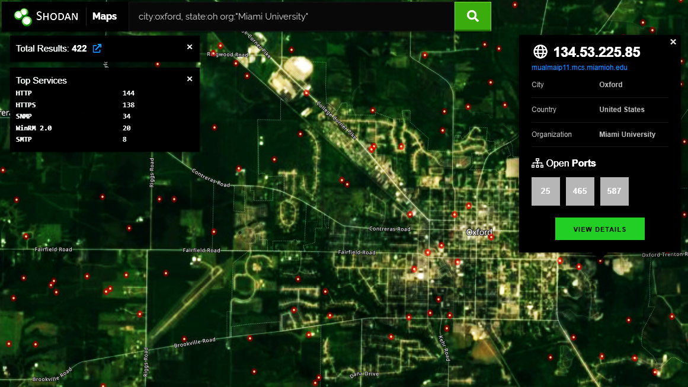
Notes:
Alongside the weak credentials and ample set of vulnerabilities, websites like Shodan make hacking these devices layman’s work
Shodan if you don't know is a search engine that shows you iot devices connected to the internet as well as their vulnerabilities. Through this website, hacking these devices has become so easy, the average joes could be looking through someone's camera or monitoring air traffic control with the click of a button.

Slide 7
Botnets
Began through Internet Relay Chat (IRC) servers
Three main Command and Control (C&C) architectures:
Centralized
Decentralized
Hybridized
Notes:
Before serving the hacker today, botnets were originally developed to assist with the administration of Internet Relay Chat (IRC) Servers
IRC became a popular method used by botmasters to send commands to individual computers in their botnet through specific channels, public IRC networks, or separate IRC servers
The phrase command and control was coined after the server containing the channels used to control the bots, and its is a critical component of botnet infrastructure
There are three main types of of command and control structures for botnets, known as centralized, decentralized, and hybridized
IRC is a text-based protocol developed in 1988 used by connected computers for real-time text messaging.

Slide 8
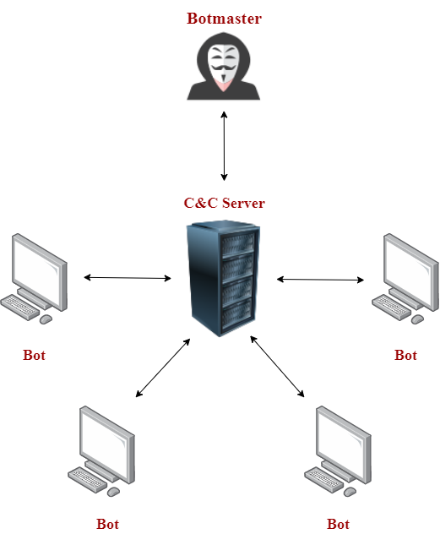
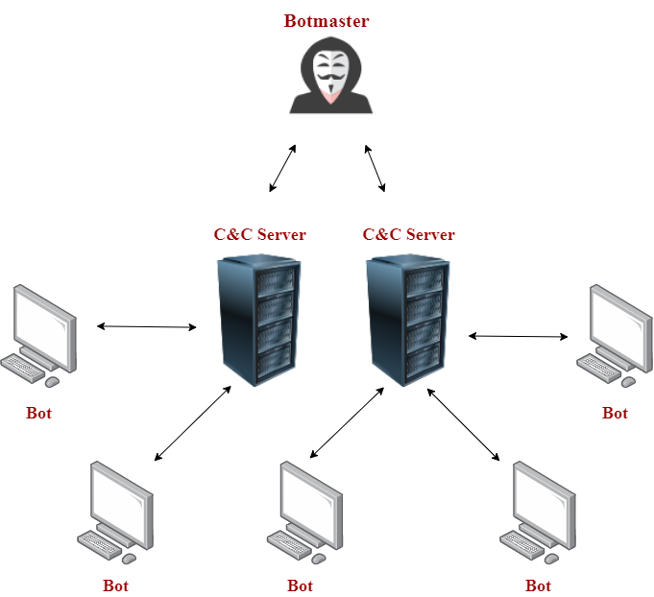
Centralized C&C Architecture
Notes:
In a centralized architecture, bots are controlled by a single server. For instance, the image in the left all the bots are controlled by one server, and on the right there are two servers but all of the bots are still controlled by one of the two servers.

Slide 9
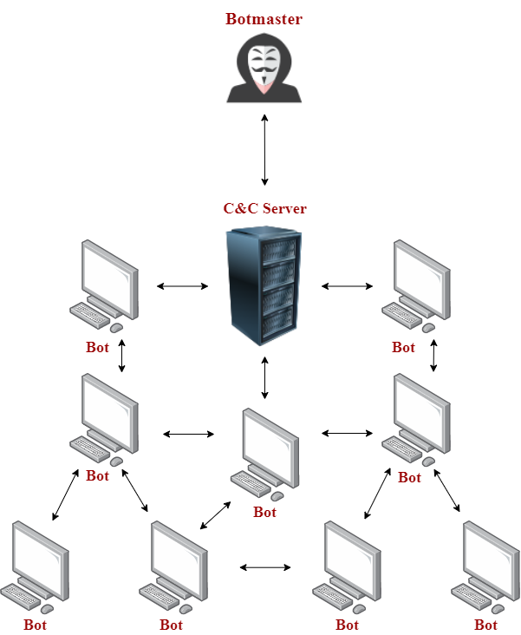
Decentralized C&C Architecture
Notes:
In a decentralized architecture, Peer-to-Peer (P2P) protocols are used so that many or all of the bots are connected. A peer-to-peer (P2P) service is a decentralized platform whereby two individuals interact directly with each other, without intermediation by a third party

Slide 10
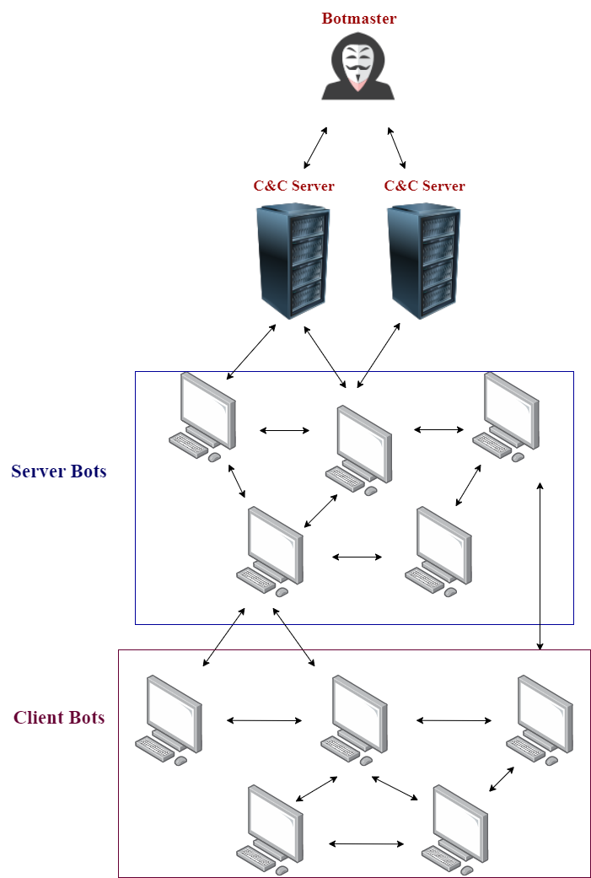
Hybridized C&C Architecture
Notes:
In a hybridized architecture, botnets use a combination of the centralized and decentralized C&C structure, often using encryption to hide botnet traffic.

Slide 11
Botnets
Life Cycle:
Initial Injection
The host device is infected and becomes a potential bot
Secondary Injection
The infected host runs a program that transforms the device into a bot
Connection
Performance
Maintenance
IMPORTANT: most vulnerable stage is connection
Notes:
Botnets have a unique life cycle whos phases are:
Initial injection
Secondary injection
Connection
Performance
And maintenance.
during initial and secondary injection, the host device is infected and transformed into a bot. During the connection phase, the bot establishes a connection with the C&C, enabling the bot to receive instruction to carry out attacks during the performance phase. Maintenance is just where the bot’s malware is updated so the botmaster can keep control of it.
Because botnets must contact C\&C servers, they are deemed to be the most vulnerable during this stage. This is because the connection phase allows botnet mitigators to identify traffic patterns and hence identify components of the botnet or the C\&C. Keep this in mind as this will become important shortly.
This is a generalization of how botnets perform in the world. Many different botnet variants circle the internet today. The three most notable variants for this research are Bashlite, Mirai, and Torii. These three bots are very important because they primarily targets are IoT devices, all three are in the dataset we utilize, and many of the additional variants surfecing today are just sophisticated modifications of these three botnets source code.

Slide 12
Motivation Continued…
Current mitigation techniques:
Virus checkers & Malware Scanners
Examples: McAfee, Malwarebytes, Norton
Intrusion Detection Systems (IDS) & Intrusion Prevention Systems (IPS)
Examples: Snort, SolarWinds Security Event Manager (SEM) IDS/IPS
Honeypots & Honeynets
New approach: Federated Learning (FL)
Notes:
To mitigate botnet and other malware spread, infections, and attacks in general, there are various different tools available on the market.
This includes virus and malware scanners, IDSs and IPSs, and honeypots.
However, these tools are very individualized in the sense Individuals or organizations will use and tailor these tools to their network. For example, when you buy a virus scanner it works for your device, but it doesnt scan viruses on your friend’s device. Also, different organizations may be the target of different types of attacks. As a result, while these tools can be efficient at protecting a system, we are missing out one massive amounts of data that could be used to track and prevent malware on a large or global scale.
The problem is, we can't just share each other's data. Data privacy is extremely important to everyone, so we want to find a way to utilize these zetabytes of information without actually compromising the devices we are getting the information from. Currently, federated learning is popular research area to address thi and similar problems.
Federated learning is an upcoming machine learning approach to training models on mass amounts of decentralized data without needing to see the raw data itself.
We will discuss more how this works later.
A honeypot is a security mechanism that creates a virtual trap to lure attackers. An intentionally compromised computer system allows attackers to exploit vulnerabilities so you can study them to improve your security policies.

Slide 13
Federated Learning
Machine learning method where multiple clients collectively train a model using their own data in a decentralized manner under the guidance of a central server
Primary Advantage: Removes a model’s need for direct access to raw training data, resulting in enhanced privacy
Cross-Device and Cross-Silo
Notes:
Federated learning is a machine learning method where multiple clients collectively train a model using their own data in a decentralized manner under the guidance of a central server
It was coined in 2016 because it is a learning task solved by a loose federation of participating devices
The primary advantage of the federated learning approach is to remove a model’s need for direct access to raw training data, resulting in enhanced privacy
Because of the emphasis on privacy, this makes the federated learning framework attractive for cybersecurity, given it will inherently protect data security and confidentiality
There are two notable types of federated learning
Cross-device and
Cross-silo

Slide 14
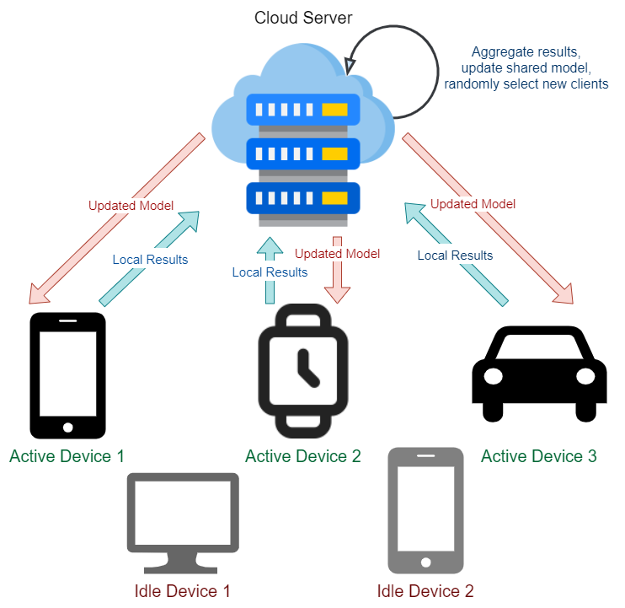
Cross-Device
Notes:
In cross-device federated learning, the clients are a very large number (i.e. thousands or millions) of mobile, edge, or IoT devices
Here each client stores its own data and is unable to see the data produced by another client
There is a central server that supervises training but does not have access to the raw data, only the model parameters returned by the clients.
So in this type of learning style, only a fraction of the clients is available via the internet or similar connections

Slide 15
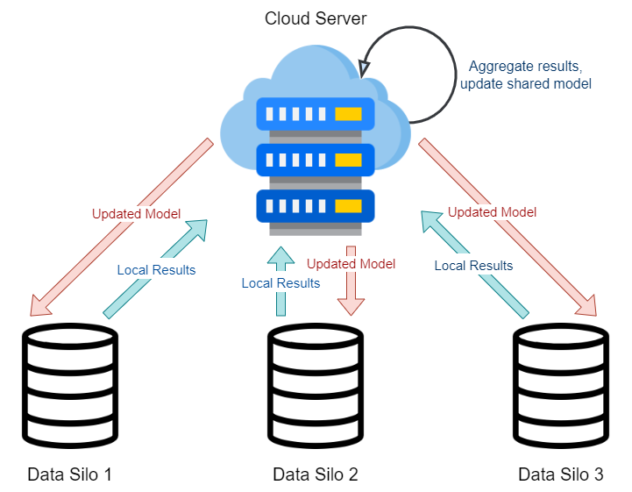
Cross-Silo
Notes:
In cross-silo federated learning, a model is trained on siloed data, making the clients different organizations or geographically distributed datacenters (typically 2 - 100 clients)
Similar to Cross-device, remains decentralized while a central server organizes training, but each client has an ID for specified access and all the clients can participate in the federation rounds

Slide 16
Research Questions
Is it possible to classify botnet malware while in the propagation and C&C phase on a packet-by-packet basis while conserving data privacy?
Can we create an Intrusion Detection System (IDS) using federated learning to predict botnet propagation before an attack occurs by analyzing the content in independent network packets?
Can we decrease model performance by simulating a targeted poisoning attack?
Notes:
So, given what we know about botnets and federated learning, we wish to track botnets using more innovative techniques to conserve data privacy. As a result, we try to answer the following questions research questions…
First, we ask if its possible to classify botnet malware while in the propagation and C&C phases on a packet by packet basis.
Second, can we create an intrusion detection system using federated learning to predict botnet propagation before an attack occurs?
And last, can we decrease our models performance by simulating a poisoning attack? A poisoning attack occurs when an adversary injects bad data into a model. We will go into a little more detail about this later.

Slide 17
Contributions
We propose a new IDS mechanism based on FL to preserve data privacy
Usage of raw packet data from real and emulated network traffic captures during propagation and C&C communication for three popular IoT botnets
We propose an online model analyzing network data on a per packet basis
A neural network model to identify botnet traffic at its early stages
We examine whether poisoning attacks have an impact on model performance
Notes:
By answering these questions, we believe our contributions are…
We propose a new intrusion detection system mechanism based on federated learning to preserve data privacy. Each device takes part in federated learning by training the model locally so no data is shared.
Usage of raw packet data from real and emulated network traffic captures during propagation and C&C communication for three popular IoT botnets.
We propose an online model analyzing network data on a per packet basis
We designed a neural network model to identify botnet traffic at its early stages (i.e. pre-attack)
We examined whether poisoning attacks have an impact on model performance. A poisoning attack occurs when an adversary injects bad data into a model. We simulate this kind of attack using label-flipping based on known malware trends.

Slide 18
Related Work
Federated learning for malware detection in iot devices (Rey et al., 2022)
Recent advances on federated learning for cybersecurity and cybersecurity for federated learning for internet of things (Ghimire et al., 2022)
A privacy-respecting android malware classifier using federated learning (Galvez et al., 2020)
A privacy-preserving federated learning system for android malware detection based on edge computing (Hsu et al., 2020)
Multi-task network anomaly detection using federated learning (Zhao et al., 2019)
Notes:
Federated learning is a relatively new research area and to our knowledge there are no real-world implementations of this approach.
There does exist a handful of publications though on federated learning in the cybersecurity field .
Rey et al. use federated learning to detect malware in IoT devices. This is the most closely related paper to our research, performing similar classifications and attacks while achieving impressive results. However, there are a few key differences:
First, we are using an more recent dataset composed of botnet propagation and command and control communication data, while they are using an older dataset composed of attack data
Second, we are examining our instances on a packet-by-packet basis similar to how an intrusion detection system would. They are using statistics collected from the packet streams, such as the weight of a packet stream, the magnitude between two streams, etc…
Ghimire et al. compiles a comprehensive survey on federated learning for cybersecurity in relation to IoT devices.
Galvez et al. and Hsu et al. present a malware classifiers leveraging federated learning for Android applications, so botnets and iot devices are not the focus
And Zhao et al. propose a multi-task deep neural network in federated learning to perform general network anomaly detection tasks, VPN (Tor) traffic recognition tasks, and traffic classification tasks simultaneously
So to our knowledge, we are the first ones to use federated learning to detect botnet propagation and communication pre-attack by conserving privacy of IoT device data on a packet-by-packet basis

Slide 19
Proposed IDS Architecture

Slide 20
Detecting Botnet Propagation
During the initial and secondary injection, the host device is infected by either weak credentials or system vulnerabilities
Detecting the early botnet phases before receiving instruction from the C&C to attack is important
We believe analyzing individual network packets may be one of the best ways to do this
Building a system that analyzes on a per-packet basis is a beneficial way to detect discrepancies between normal and malicious traffic
Notes:
As mentioned earlier, the ability to detect the early botnet phases before receiving instruction from the C&C to attack is important.
We believe analyzing the individual network packets may be one of the best ways to do this.
If we can identify communication traffic, we can more likely identify the C&C and put up defenses against it
We believe a system that analyzes on a per-packet basis is a beneficial way to detect discrepancies between normal and malicious traffic.

Slide 21
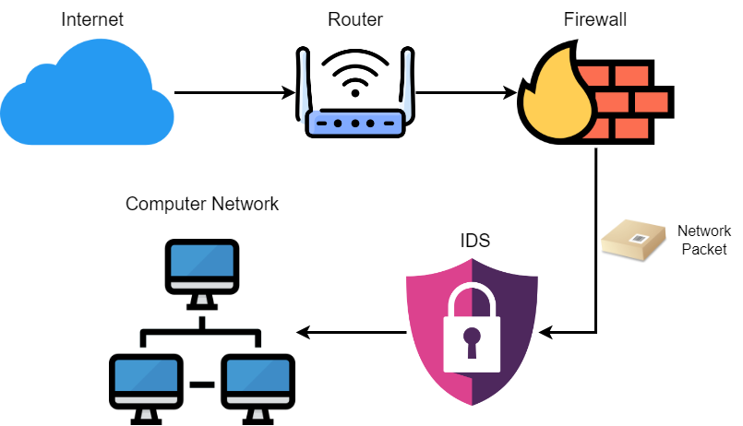
Standard IDS
Notes:
the standard intrusion detection system is a software application used to monitor networks for malicious traffic. A standard IDS can be broken up into various types, such as etwork-based, host-based, signature-based, and anomaly-based
When a router connects to the internet, a firewall is commonly put up to block specified malicious traffic. An IDS can be placed after the firewall, then whatever traffic passes through the IDS is allowed to enter the private network.
We propose a slightly different architecture.
Notes:
Network-based IDS systems analyze network traffic
host-based analyze operating system files
signature-based analyze patterns/signatures of malware
anomaly-based analyze unknown attacks using machine learning. Anomaly-based IDS solutions model “normal” behavior within the system, labeling packets as potential threats if they present anomalous behavior. This is beneficial for a closed or private organizational network where there could be such a thing as “normal” traffic behavior, but this becomes difficult to pinpoint as open networks and IoT devices grow in size.

Slide 22
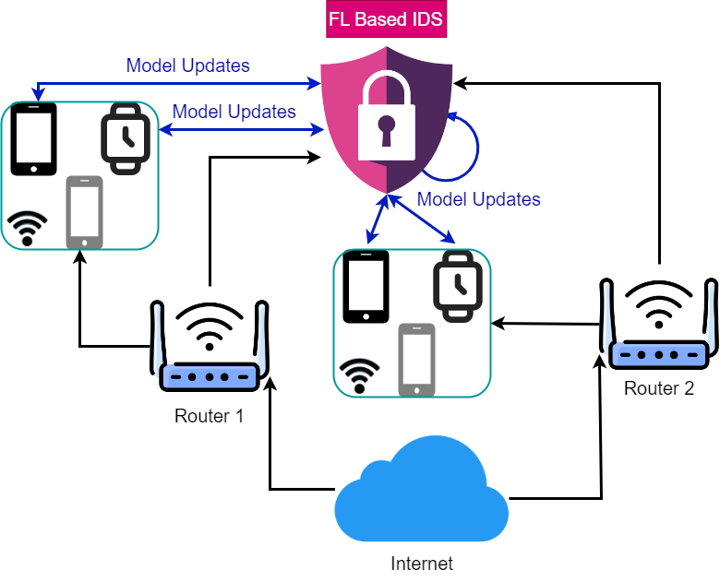
Proposed IDS
Notes:
In our proposed IDS, we want to use federated learning to detect anomalous traffic because it conserves data privacy.
We are concerned with data privacy because network packets hold an array of information that could be used to cause harm
A good example is an IP addresses. Anyone can use your IP address to track and follow you around if not kept private.
As a result, we don’t want to pass or transport any raw data past the device, just the model weights to conserve privacy and confidentiality
In theory our IDS would be connected to different routers, therefore being connected to different networks. Within each network, the IDS should be able to randomly select any device connected to that network for model training. The central IDS or server will distribute its model to the selected devices, and each device will run the model on its own network data. Devices would not have to share their network data with other devices or the IDS. The devices send their updated model weights back to the IDS for it to average and distribute to a new randomly selected set of devices.
A typical IDS sees all the network traffic coming into a network. Our approach allows us to connect to multiple networks, allowing us to process more data without actually seeing the data. More data from different networks allows us to build better models because they will have more content to learn from.
Another important difference is in an anomaly-based IDS, machine learning is used to model “normal” behavior within the system, labeling packets as potential threats if they present anomalous behavior. However, it is very easy for botnet propagation and command and control communication traffic to blend in with normal traffic. So our approach tries a more active approach to differentiate between benign and malicious traffic.
Notes:
why would we want to keep network data private to the device? Packets hold an array of information that could be used to cause harm if it falls into the wrong hands. A good example is IP addresses. Anyone can use your IP address to track and follow you around if not kept private. Based on the destination address you send information to, anyone could also exploit you via your browsing history and internet activity. People can also sniff traffic if the communication channels are not secure. As a result, we don’t want to pass or transport any raw data past the device, just the model weights to conserve privacy and confidentiality.

Slide 23
Poisoning Attack
Poisoning attacks happen when a hacker tries to inject fake training data into a model to reduce or hinder its performance
Four main categories of poisoning attacks:
Logic Corruption
Data Manipulation
Data Injection
Domain Name System (DNS) Cache Poisoning
We replicate a data manipulation attack where we switch malware labels to benign
Notes:
To test the robustness of our model, we also perform a poisoning attack to analyze how output is affected.
Poisoning attacks happen when a hacker tries to inject fake training data into a model to reduce or hinder its performance.
There are four main categories of poisoning attacks:
logic corruption
data manipulation
data injection
Domain Name System (DNS) cache poisoning
The type of poisoning attack we try to replicate is a data manipulation attack
Since we are using supervised learning, we emulate an attack as if a malicious user switched the malware labels to benign to cover up bad traffic
Notes:
Logic corruption is where the attacker changes the logic of the systems to disrupt how the system learns [35].
Data manipulation is where the attacker manipulates the data rather than the logic [35].
Data injection is when fake data is inserted into the actual dataset to skew model results and weaken outcomes [35].
Last, DNS cache poisoning is when the attacker corrupts DNS data, causing the name server to return incorrect results [35].

Slide 24
Dataset Compilation & Processing

Slide 25
Exploring Available Datasets
Original Plan: Install Mirai and let it propagate amongst virtual machines
Available Datasets
X-IIoTID (2021)
MedBIoT (2020)
IoT-23 (2020)
Kitsune (2019)
N-BaIoT (2018)
Reasons for Pursuing MedBIoT:
Traffic Type (Pre-Attack)
Malware Type (Bashlite, Mirai, Torii)
Notes:
Before even looking at datasets, we tried to run souce code from a popular botnet known as Mirai our own using virtual machines to capture real-time network traffic. Unfortunately, we faced many issues with this, including issues with running the source code, setting up the virtual machines, incompatibilities between Microsoft and Linux distributions and lack of Microsoft certificates, and operating system version incompatibilities. As a result, we had to switch gears and search for datasets containing botnet traffic.
The datasets shown on the screen are popular published datasets relating to malware network traffic.
We chose to use MedBIoT, a dataset published in 2020 for a variety of reasons
We liked MedBIoT because it contained real-time traffic data from three prominent botnets known as Bashlite, Mirai, and Torii. Many more recent and sophisticated variants base their source code on these three botnets because these botnets (especially Mirai) were the first first to utilize IoT devices for DDoS attacks.
The data is compiled of network traffic from multiple emulated and real IoT devices and does not contain data from any other forms of malware
And the biggest perk is this dataset only contains propagation and C&C communication traffic, not attack traffic.

Slide 26
Converting PCAP to CSV
PCAPs are the raw packet captures
CSVs are the processed features from those packets
MedBIoT pcap files:
Bulk: Separated by source type (i.e. legitimate, Mirai, Bashlite, Torii)
Fine-grained: Separated by data source, botnet phase, and device type
<SOURCE TYPE>_<TRAFFIC TYPE>_<PHASE>_<DEVICE>.pcap -> mirai_mal_CC_lock.pcap
Tools: Wireshark & Terminal Wireshark (tshark)
Notes:
The MedBIoT dataset consist of bulk and fine-grained pcap files
The bulk data was separated by botnet type, and the fine-grained data was further separated by botnet type, botnet phase, and device type.
Pcaps are raw packet captures, so these needed to be converted to csv format for data processing.
To do this, we used wireshark and tshark. Wireshark is a free and open-source packet analyzer, and tshark is the command line version of that tool.

Slide 27
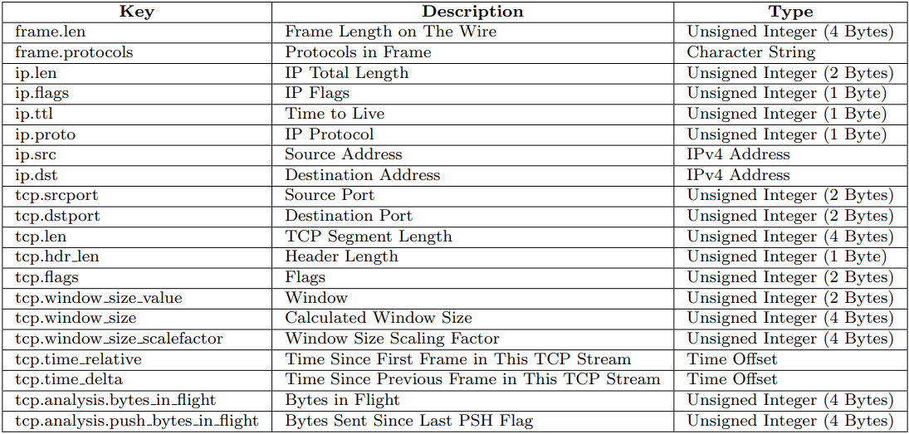
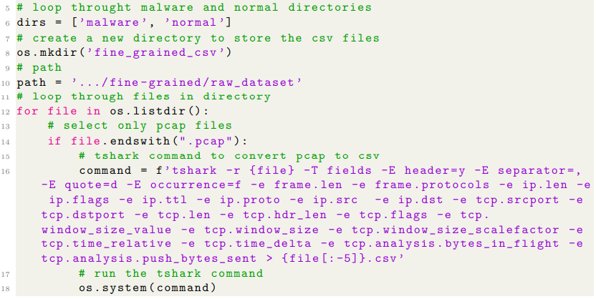
First Set of Selected Features
Notes:
After discarding the features for the reasons just mentioned, we ended up with the fields shown on the screen.
Using each field name, we used tshark to go through the fine-grained pcap files and convert them to csv format

Slide 28
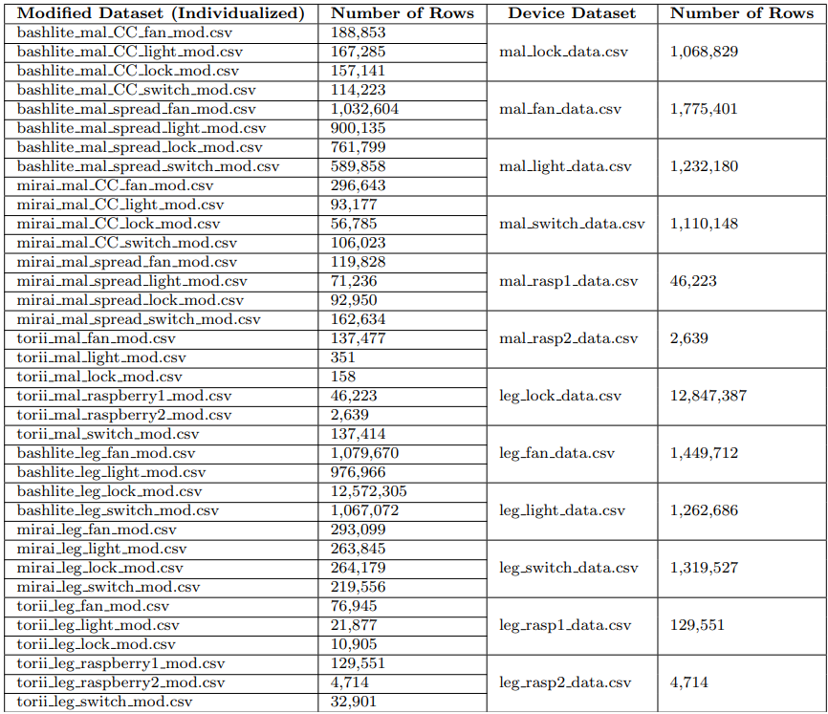
Combining Datasets
After modification, we combined the fine-grained datasets based on device type and whether they were malicious or benign
Selected 2,000 rows from each
Single dataset totaling 24,000 data points (rows)
Notes:
Once we modified the individual fined-grained csv files, we then combined them based on device type and whether they were malicious or benign.
Then, we randomly selected 2,000 rows from each csv, creating a single dataset consisting of 24,000 rows

Slide 29
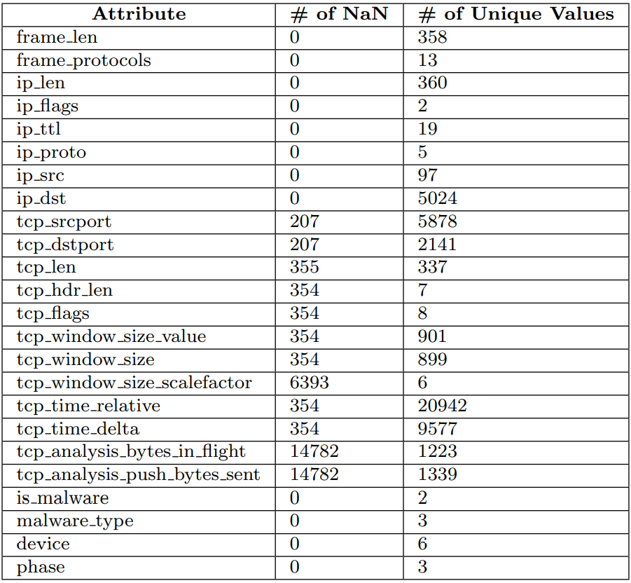
Removing More Features
Once combined into a singular dataset, we dropped more features based on number of NaN values
Notes:
Then once we had our singular dataset, we dropped a few more features based on the number of NaN values they had.
The table displays the number of NaN values for each feature. So for example, we dropped tcp_analysis_bytes_in_flight because it had over 14000 null values.
Once we dropped these feature, we performed a final dropna() to get rid of any remaining values rows with missing values.
We ended up going from 24,000 rows to 23,793

Slide 30
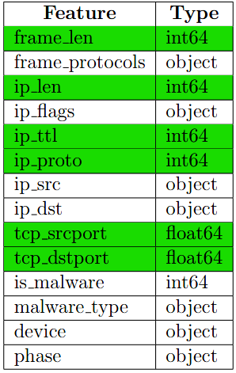
Final Set of Features
Began with 54 features (excluding labels)
Cut it down to 20 features (excluding labels)
Added four labels, totalling 24 features
Cut it down to 14 features (including labels)
Used numerical features (predictors) and one label (is_maware)
Notes:
So in summary, we began with 54 features, dropped it down to 20 the first round, then dropped it down to 14 the second round based on the number of nulls. Then due to issues encoding categorical variables, we then decided to just stick to numerical features to use a predictors of malware. So after another round of cutting, we ended up with 6 predictors (highlighted in green) and used to predict one label.
You might be wondering to yourself, federated learning is supposed to be able to process massive amounts of data, so why did we cut so much? Well, we originally produced a dataset i think over 20Gbs in size. This dataset we ended up using was like the third or fourth dataset we made. We did not have access to the red hawk cluster, and we were too far into the process for me to learn how to use it and us to get permission and migrate our stuff there. So we had to reduce the size of out dataset significantly in order to process the data within reasonable batches of time. Using this smaller dataset, we got to a point where running our experiments took around three hours.

Slide 31
Experiment Setup

Slide 32
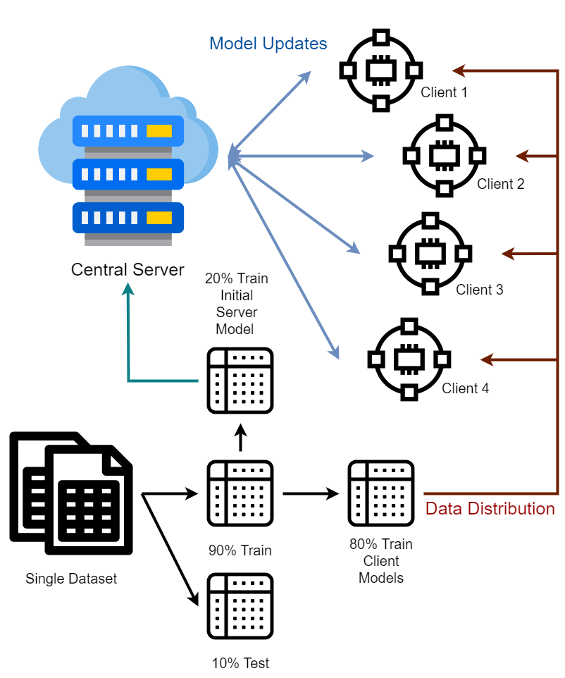
Model Overview
Notes:
Moving forward, we abandoned the TFF API and referenced the model used in a recent IEEE paper published last year . This paper discussed covid19 prediction using asynchronous federated learning-based radiograph screening booths.
That model is outlined here.
Once we had our dataset, we scaled our data using a minmax scaler, then split our data using a test size of 10%. We also set a seed of 123 to enforce consistency throughout the experiments.
We then split the train. We used 20% of this data to train an initial model to give to the server to distributed amongst the clients. The remaining 80% of the data was split amongst four clients.
The server then distributed its model to the clients, the clients processed their individual data, and sent the model weights back to the server. Once the client model was updated, we stored the client model weights in a list, then sent them to the server where they were summed and averaged. Once the server updated its model using the averaged values, the model was saved and sent to the clients, and the process repeated

Slide 33
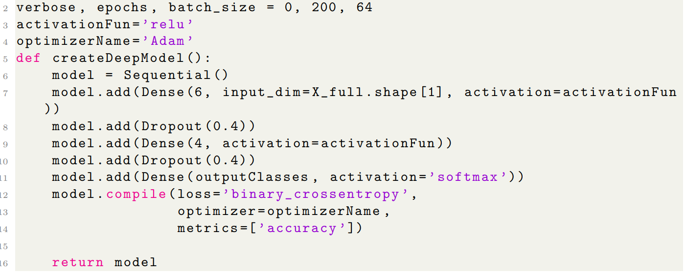
Neural Network
Notes:
This slide depicts the neural network model we used. We made a very simple model. The first layer took 6 inputs (the 6 predictors we talked about before), we added a few dropouts to prevent overfitting, and we had a binary output of 1 for malware and 0 for benign traffic.

Slide 34
Hyperparameters
Ran the experiment 10 times
Number of clients: 4
Batch size: 64
Number of epochs: 200
Tested out 400, saw no significant improvement
Learning rate: 0.001
Tested 0.01, saw no significant improvement
Number of iterations: 50
Notes:
This slide summarizes the hyperparameters we used. We ran our experiment 10 times to gain a holistic view of how the model performed.
In addition to all of this, we also ran the poisoning attack mentioned before

Slide 35
Malicious Model (Poisoning Attack)
Same setup as before, except…
One Client
Source Port: 23 (Telnet)
Flipped labels from malicious to benign (1 to 0)
Notes:
To make things simple, I’ll refer to the poisoning attack model as the malicious model, and the model absent of the attack as the benign model
For our malicious model, we followed the same setup as our benign model, but manipulated the data for 1 of the 4 clients.
After splitting the data into train and test sets, we looked up the most popular port for the malware data, and found that Telnet (port 23) was at the top of the list.
Telnet is an application protocol that allows users to interact with remote systems, and secure devices should have this port closed because credentials submitted through telnet are not encrypted, leaving clients vulnerable to data leaks.
After splitting the data amongst the clients, we went through every row in the first client, and if a row contained a source port of 23, we flipped the label from 1 to 0 to trick the model into identifying the data point as benign.
Outside of this, everything remained the same as far are the experiment design

Slide 36
Results & Discussion

Slide 37
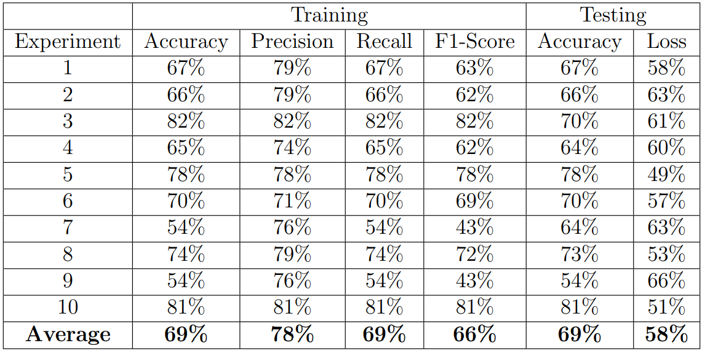
Benign Model
Notes:
To measure the efficiency of our model, we tracked the accuracy, precision, recall, and f1 score.
During training…
our model produced an average accuracy of 69%, precision of 78%, recall of 69%, and F1-score of 66%.
We see less fluctuation in precision than accuracy, and our precision values are higher than our accuracy values. Our recall is the same as our accuracy, and our F1-score is less than all accuracy, precision, and recall.
This fluctuation is very likely due to randomness. Due to time constraints, we were not able to perform k-fold validation for our model. In the future, however, we believe using k-fold validation may further validate our results and reduce this random fluctuation.
During testing….
On average, we achieve an accuracy of 69% and a loss of 58%. Meaning on average, we achieve the same accuracy during testing as we did during training
Notes:
Precision describes how accurate the model is out of the predicted positives, making it a good measure, when the costs of false positives (FP) are high citeshung2018. In our case, a FP would be benign traffic being classified as botnet traffic. Recall describes the number of actual positives captured, making it a good measure when the cost of false negatives (FN) are high. In our case, a FN would result in botnet traffic being classified a benign traffic. For our research, the cost of FN is higher than that of FP, so we pay close attention to recall and precision (more so recall) over accuracy. The f1 score is used when seeking a balance between precision and recall in the presence of an uneven class distribution [44]. It places an emphasis on the importance of FP and FN, where as accuracy places more importance on TP and TN [43]. As a result, we are also more interested in the f1 scores produced by our model more than accuracy.

Slide 38
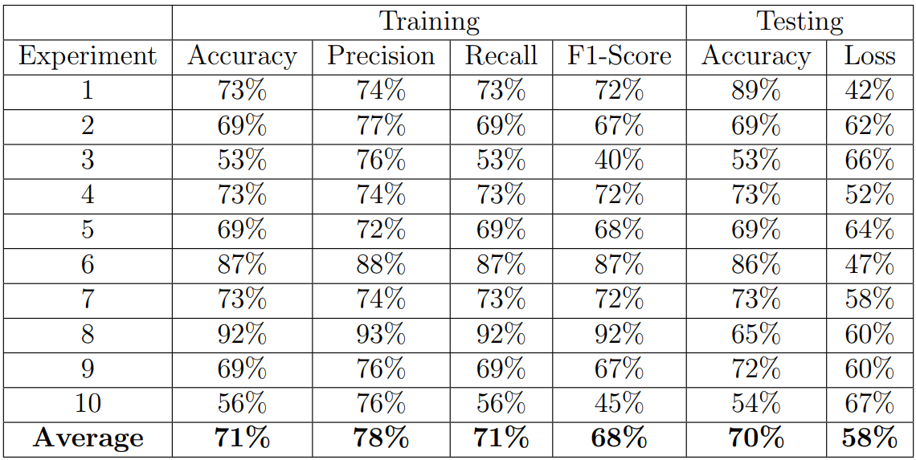
Malicious Model
Notes:
We also tracked the same scores for our malicious model
During training…
our model produced an average accuracy of 71%, precision of 78%, recall of 71%, and F1-score of 68%.
Compared to our results in the previous slide, this is initially unexpected as label-flipping achieves higher accuracy, the same precision, higher recall, and a higher f1-score. It should be the opposite.
We see less fluctuation in precision than accuracy, and our precision values are higher than our accuracy values.
Our recall is the same as our accuracy, and our F1-score is mostly less than all accuracy, precision, and recall.
During testing….
On average, we achieve an accuracy of 70% and a loss of 58%
Meaning on average, we achieve a slightly lower accuracy during testing than we did during training
Compared to our benign model, we have slightly higher accuracy and the same loss.

Slide 39
Conclusion

Slide 40
Limitations & Drawbacks
Federated learning exists in simulated environments
Models must be tailored to fit data, rather than tailoring data to fit the model
Network packets may have missing values, outliers, and imbalances
IoT devices have varying levels of computational power, battery life, and bandwidth
Possibility of devices dropping
Random selection of devices and selection bias
Notes:
To our knowledge, federated learning models only exist in simulated environments and are not utilized publicly in the real world. There are a handful of reasons for this. One is that these models have to be tailored to fit the data, rather than tailoring the data to fit the model like most centralized approaches
In regards to network data, the reality is many packets could have missing values, outliers, and an unbalanced distribution of malware and normal traffic depending on the security of the system and network.
Devices, especially IoT devices, also have different levels of computational power and battery life.
There is also the issue of how many devices to randomly select for training, and making sure that there isn’t a bias as to which devices to select
We initiated the process of trying to detect discrepancies on networks using a federated learning-based intrusion detection, but, more has to be done for this idea to be used in real-world applications.

Slide 41
Future Work
What we did:
Tracked botnet propagation on a per-packet basis
Created a model
Performed a poisoning attack
What can be done in the future:
Refining the model (hyperparameters, layers, clients, nodes, cross-validation)
More robust features selection
Test different poisoning attacks
Account for device dropping
Notes:
In this work, we tried to track botnet propagation on a packet-by-packet basis. This difficult because botnet traffic can easily blend in with regular traffic during propagation and C&C communication pre-attack.
Therefore, more work should be done in the future to potentially produce a better federated learning models
First, researcher should test different types of neural network models. We messed with different hyper parameters such as softmax vs relu, adam vs sgd, accuracy vs binary accuracy, cross-entropy vs binary cross-entropy, and so one. There are endless possibilities of the types of NN models that could be made.
Researcher should also test larger numbers of clients and see if they can withstand devices dropping from model processing. We tested up to 10 clients, but results were less favorable, probably because splitting the data 10 ways was not enough for each client to train.
More time should be spent on an in-depth analysis of feature selection. Packets contain a lot of data different types of data that could be useful
Then, k-fold cross-validation could be tested to see how it impacts model fluctuation.
last, different poisoning attacks should be used until model performance is visibly reduced. This will help researchers understand what types of tailored attacks hackers might use and help them build their model to appropriately defend against such attacks

Slide 42
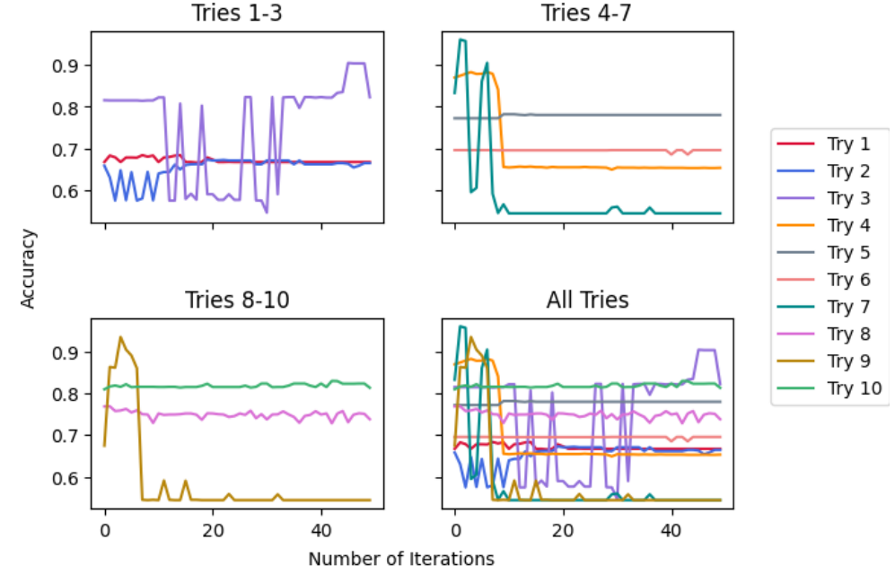
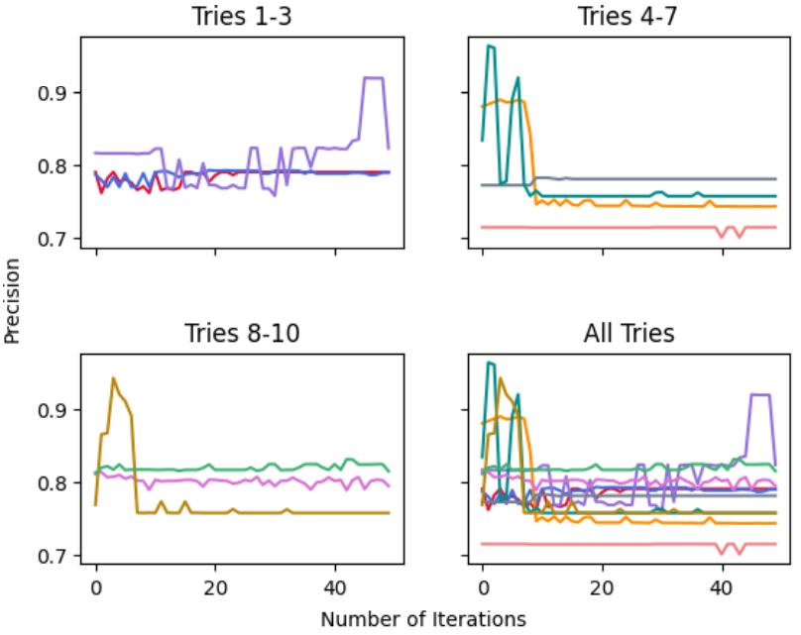
Benign Model (Training)

Slide 43
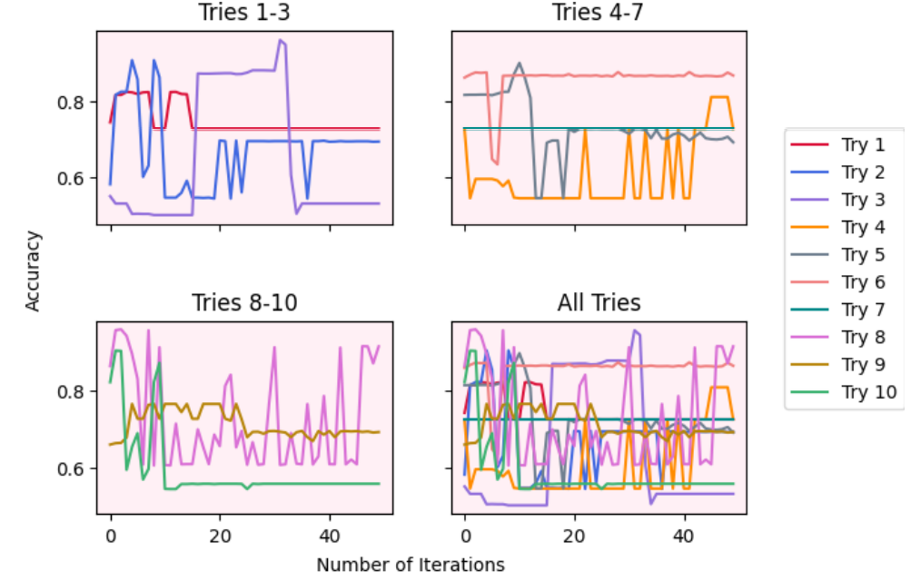
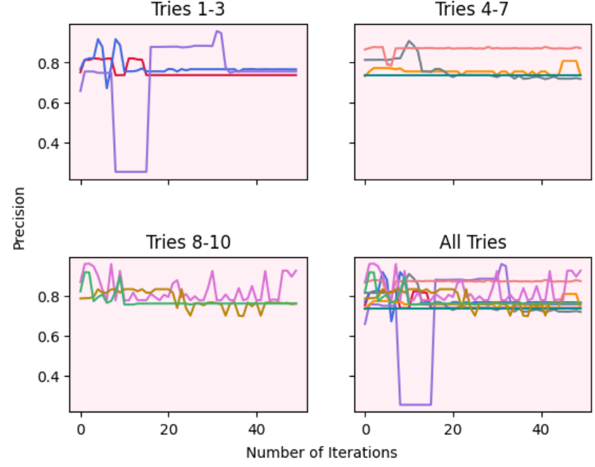
Malicious Model (Training)

